Slide 1
Unit-II
Functional Areas of Management

Slide 2
Functional areas of Management:
Production: Production is the process of converting input into output is called as production.
Production is the creation of goods and services “Production is the organization activity of transforming resources into finished products in the form of goods and services”.
Michel R. Baye- “that function which defines the maximum amount of output that can be produced with a given set of inputs”.
It is a physical aspects
Concern with engineer rather than manager
Required technical knowledge

Slide 3
The production Function:
Production is the result of the combinations of factors for the creation of values and utility to the corresponding commodities. The factors of production are namely Land, Labour, Capital, Organization and Technology.
Production Function: The function for the production is stated as:
Q = f{L_{1,} L_{2,} C, O, T}
Where Q = Quantity of Production, F = Relation between Inputs and Outputs, L₁ = land, L₂= Labour, C = Capital, O = Organization, T = Technology.

Slide 4
Characteristics of production system
Production is an organized activity, so every production system has an objective.
The system transforms the various inputs to useful outputs.
It does not operate in isolation from the other organization system.
There exists a feedback about the activities, which is essential to control and improve system performance.

Slide 5
Functions of production management:
Selection of product and design:
Production planning and control
Machine maintenance and replacement
Importance of production management
Efficient use of capital and resources
2. Competitive edge
3. Minimizes risk of product failures

Slide 6
Production and Operation Management
Production and operation management is defined as the design, operation, and improvement of transformation process, which converts the various inputs into the desired outputs of products and services.
According to E.S.Buffa “Production management deals with decision making related to production process so that result the goods or services are produced according to specifications in the amounts and by the scheduled demanded and at minimum cost.’’

Slide 7
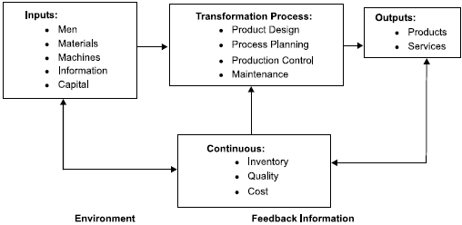
Production system

Slide 8
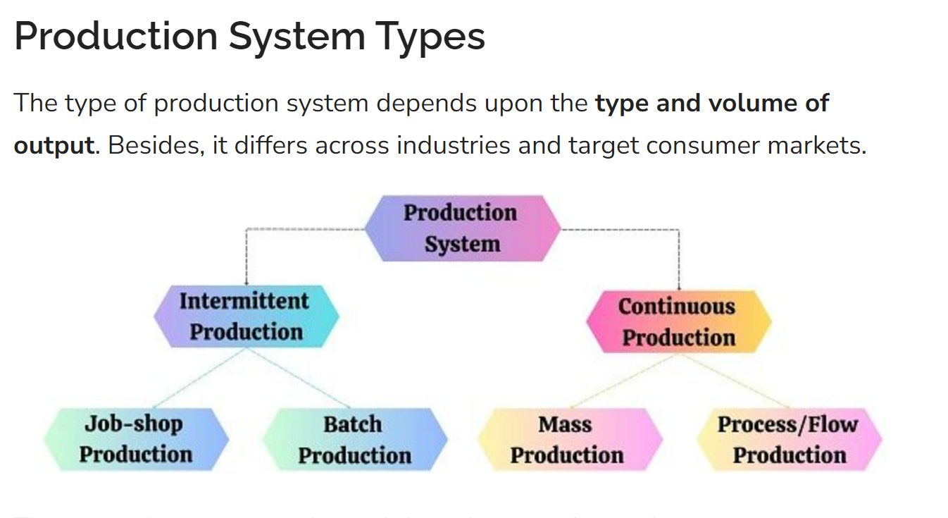

Slide 9
1. Intermittent Production
It is a type of production system where the production flow is intermittent or irregular. It means the production process begins and stops at irregular intervals.
Here the production is carried out based on the customer orders, i.e. Make-to-order. Consequently, the producer can customize their products as per the orders received.
Each time the jobs and route are changed depending on the order received. Therefore, the producer needs to install general-purpose production equipment.
Features of Intermittent Production
Order-based production of goods.
Production on a smaller scale.
Flexibility in production.
Production of a greater variety of products.

Slide 10
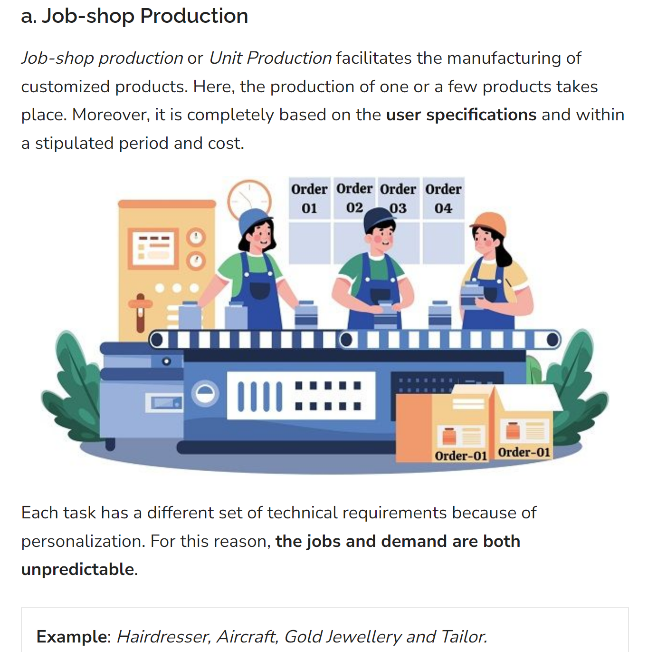

Slide 11
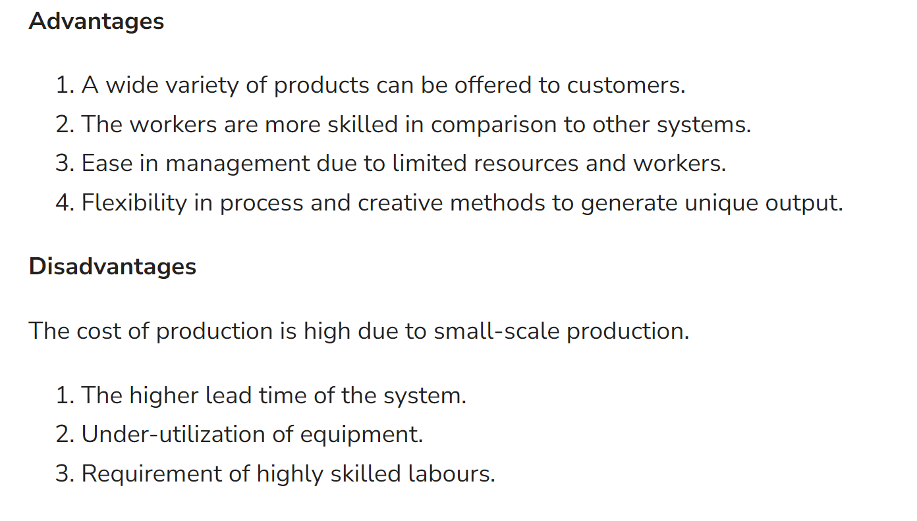

Slide 12
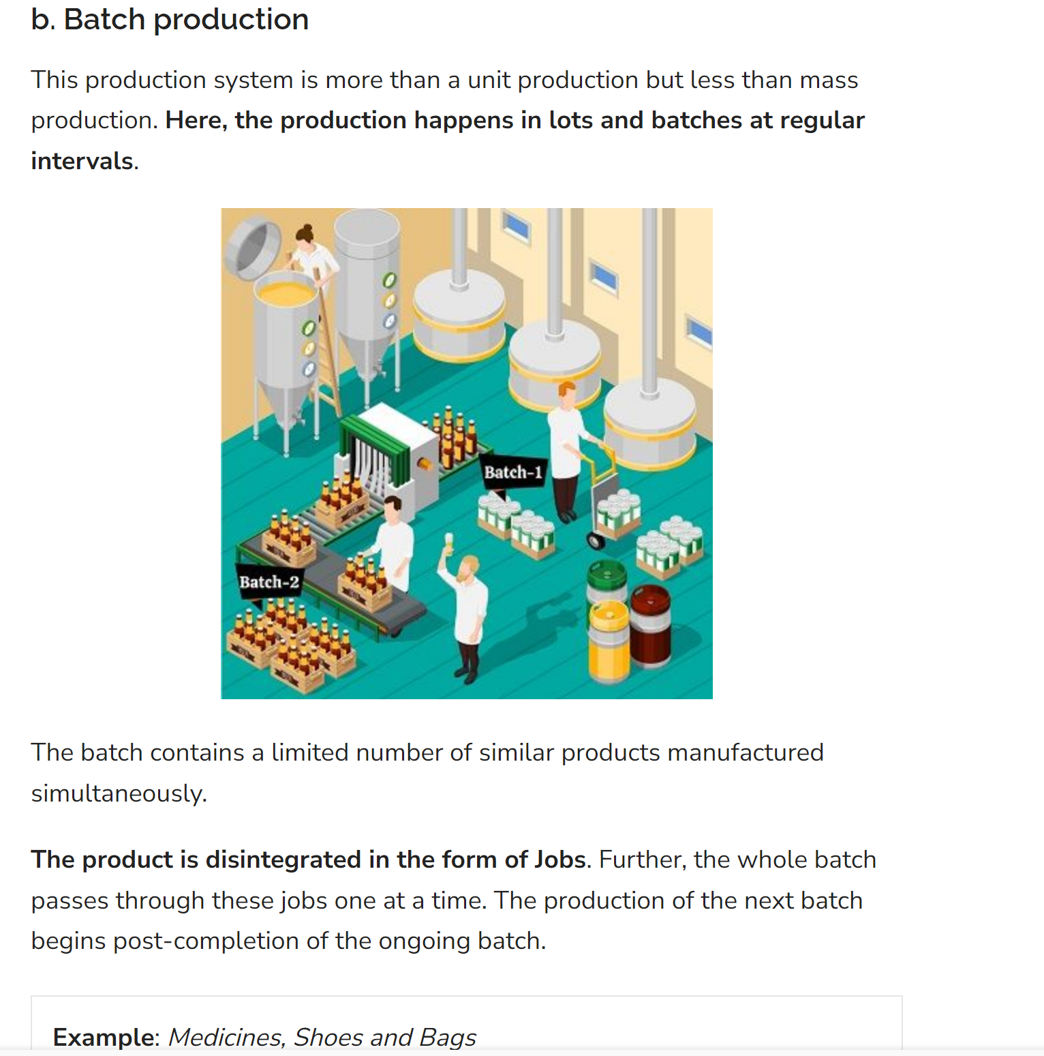

Slide 13
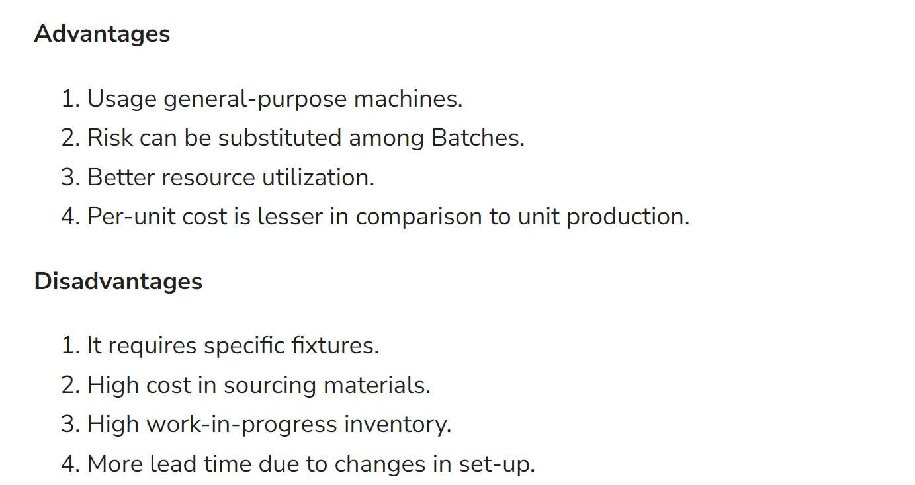

Slide 14
2. Continuous Production
Here, the production occurs continuously with a consistent supply of materials. In other words, the products are constantly in motion.
Unlike intermittent production, there are no frequent halts. The production is carried out on a large scale. The companies maintain the inventory as per demand forecasts.
Identical goods are produced due to product standardization and bulk production.
Features of Continuous Production
Complete utilization of equipment and raw materials.
Production at large scale.
Per-unit cost is less due to bulk production.
Less lead time as the set-up is required only at the beginning.
Highly automated and capital-intensive system.

Slide 15
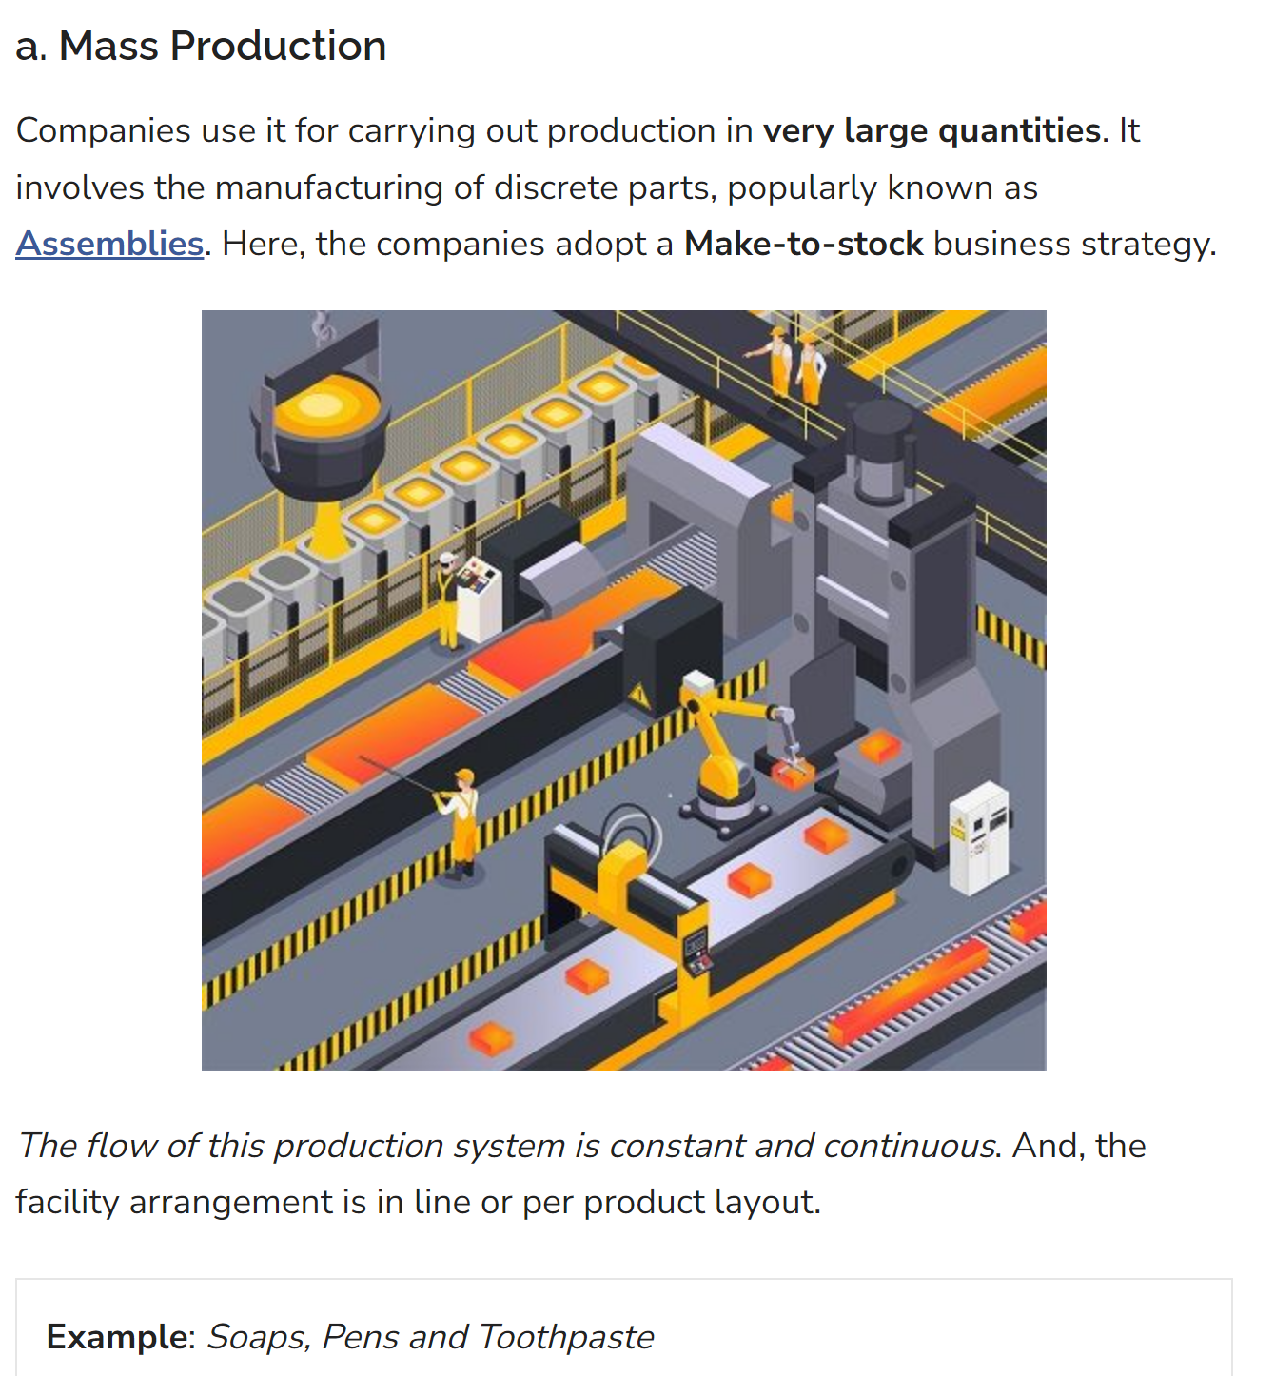

Slide 16
Advantages
The cycle time is comparatively less.
Automation of material handling.
Low work in progress.
The cost of production is low.
Disadvantages
Default at one place may stop the entire production.
Line layout needs changes with the change in product design.
High capital investments.

Slide 17
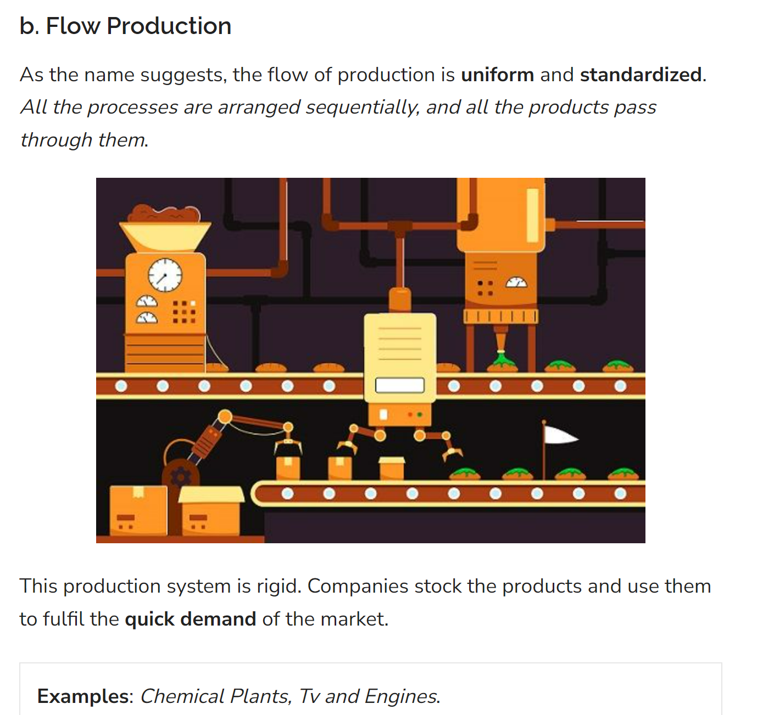

Slide 18
Advantages
Less amount of wastage.
Semi-skilled can also be employed.
Higher profit margins.
The process flow is constant.
Disadvantages
Less flexible to increase or decrease the number of processes.
Restrictions on product differentiation.
Incapable of fulfilling individual demand.

Slide 19
Types of production systems/systems of production
Production systems can be classified as
Job-shop production
Batch production
Mass and Continuous production systems.
Project type

Slide 20
Job-Shop Production
Job-shop production
are characterized by few quantity of products
manufacturing one or
designed and produced as per the specification of customers within prefixed time and cost.
The distinguishing feature of this is low volume and high variety of products.
A job-shop comprises of special-purpose machines arranged into different departments. Each job
demands | unique | technological | requirements,
demands | processing | on machines | in a certain
sequence. | Example: Restaurant

Slide 21
Characteristics of job shop
High variety of products and low volume.
Use of special purpose machines and facilities.
Highly skilled operators who can take up each job as a challenge because of uniqueness.
Large inventory of materials, tools, parts.
Detailed planning is essential for sequencing the requirements of each product, capacities for each work centre and order priorities.

Slide 22
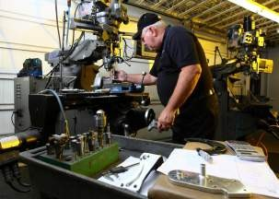
This type of system has more flexibility. But this system result into more set-up time , more in-process inventory ,complex scheduling
Example-Repair shops,large tyrbo-generators, restaurant etc

Slide 23
Batch Production
American Production and Inventory Control Society (APICS) defines Batch Production as a form of manufacturing in which the job pass through the functional departments in lots or batches and each lot may have a different routing.
It is characterized by the manufacture of limited number of products produced at regular intervals and stocked awaiting sales.
Shoe manufacturing ,Bottling plant , Cloth manufacturing, biscuit manufacturing

Slide 24
Characteristics of Batch Production
1. Shorter production runs.
2. Plant and machinery are flexible.
3. Plant and machinery set up is used for the production of item in a batch and change of set up is required for processing the next batch.
4. Manufacturing lead-time and cost are lower as compared to job order production

Slide 25
Mass Production
Manufacture of discrete parts or assemblies using a continuous process are called mass production.
This production system is justified by very large volume of production.
The machines are arranged in a line or product layout. Product and process standardization exists and all outputs follow the same path.
Ex- Auto Manufacturing ,TV Manufacturing ,Cigarettes

Slide 26
Characteristics of Mass Production
Standardization of product and process sequence.
Dedicated special purpose machines having higher production capacities and output rates.
Large volume of products.
Shorter cycle time of production.
Low process inventory
Perfectly balanced production lines.
Flow of materials, components and parts is continuous and without any back tracking.
Production planning and control is easy
Material handling can be completely automatic

Slide 27
Advantages
Higher rate of production with reduced cycle time.
Higher capacity utilization due to line balancing.
Less skilled operators are required.
Low process inventory.
Manufacturing cost per unit is low.

Slide 28
Continuous production
Production facilities are arranged as per the sequence of production operations from the first operations to the finished product.
The items are made to flow through the sequence of operations through material handling devices such as conveyors, transfer devices, etc.
Ex -Oil refining, Fertilizer production, Chemical processing etc.

Slide 29
Characteristics
Dedicated plant and equipment with zero flexibility.
Material handling is fully automated.
Process follows a predetermined sequence of operations.
Component materials cannot be readily identified with final product.
Planning and scheduling is a routine action.

Slide 30
Project type
A project refers to the process of creating a complex one 0f a kind product or service with a set of well defined tasks in terms of resources required and time phasing.
Project production consists of many activities where the activities are interlinked, time phased and resources committed.
EX: Ship construction, dam construction, bridge construction,
The resources, namely, manpower, machines, material are brought to the workplace where the product is manufactured.

Slide 31
Importance
It helps to cut down cost per unit and thereby improve the profits.
Gains from productivity can be transferred to the consumers in form of lower priced Products or better quality products.
A more productive entrepreneur can have better chances to exploit expert opportunities.
It would generate more employment opportunity.
Overall productivity reflects the efficiency of production system.

Slide 32
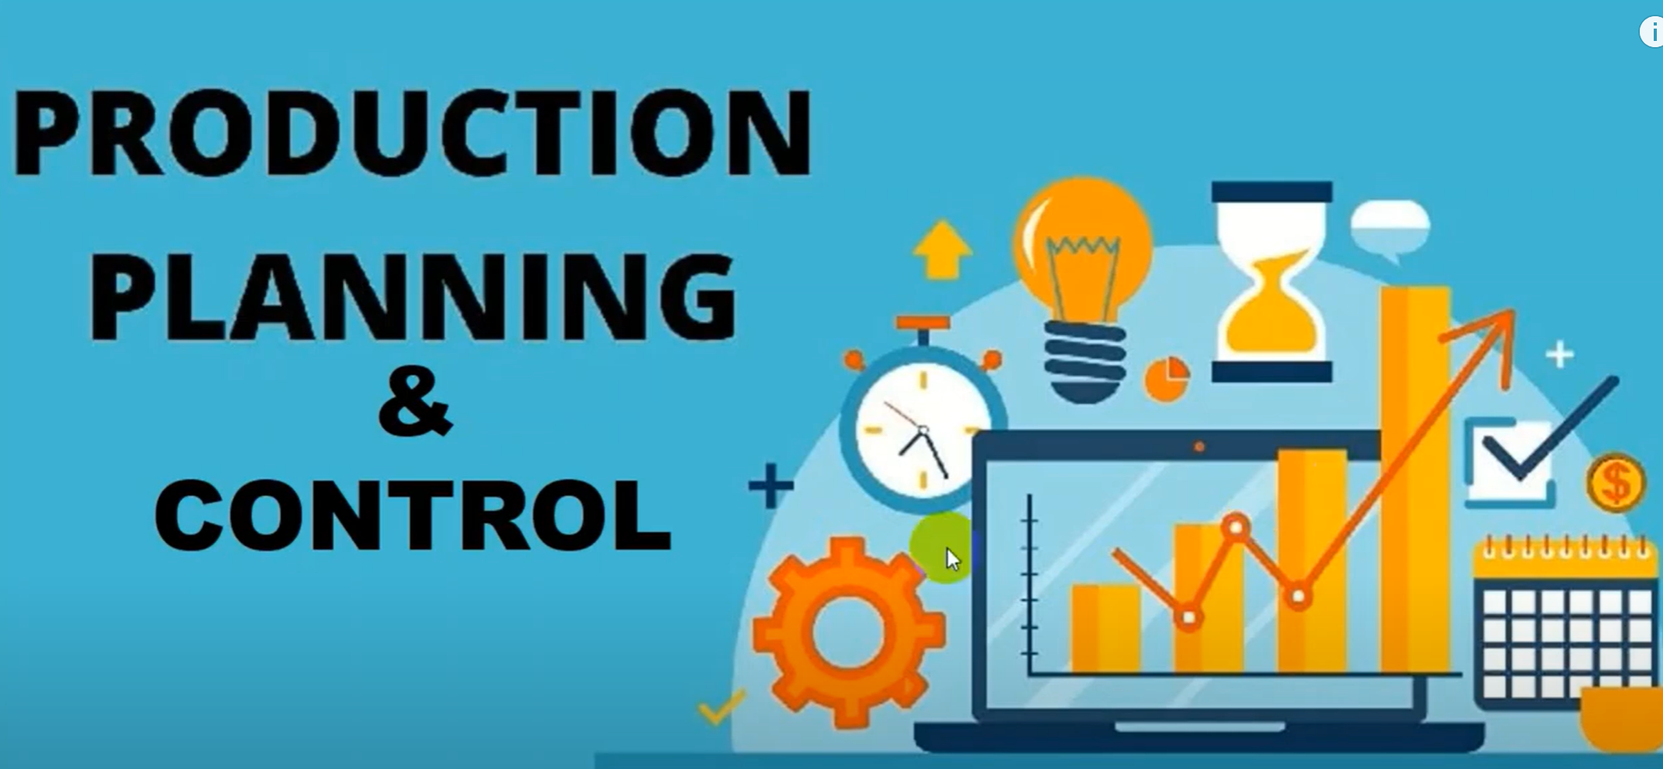

Slide 33
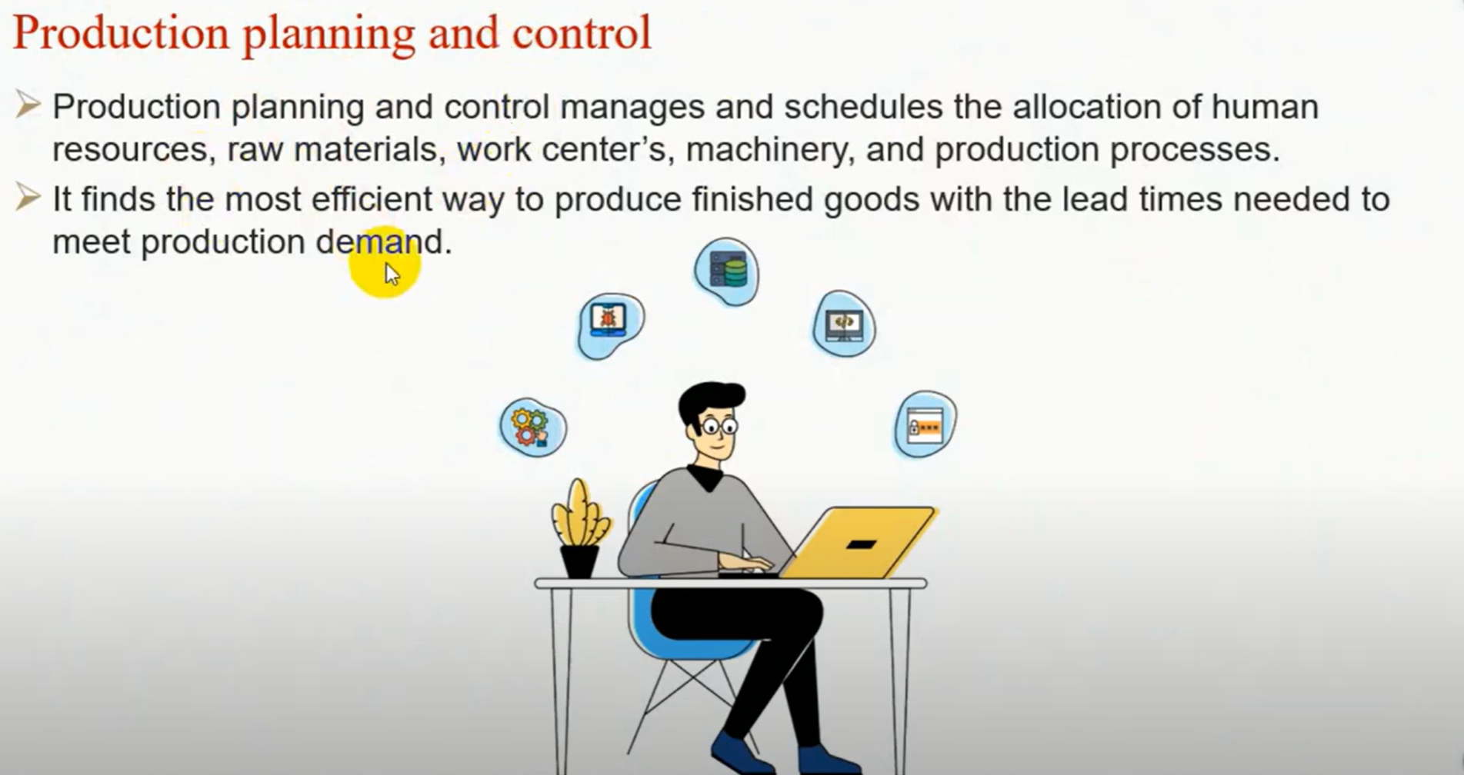

Slide 34
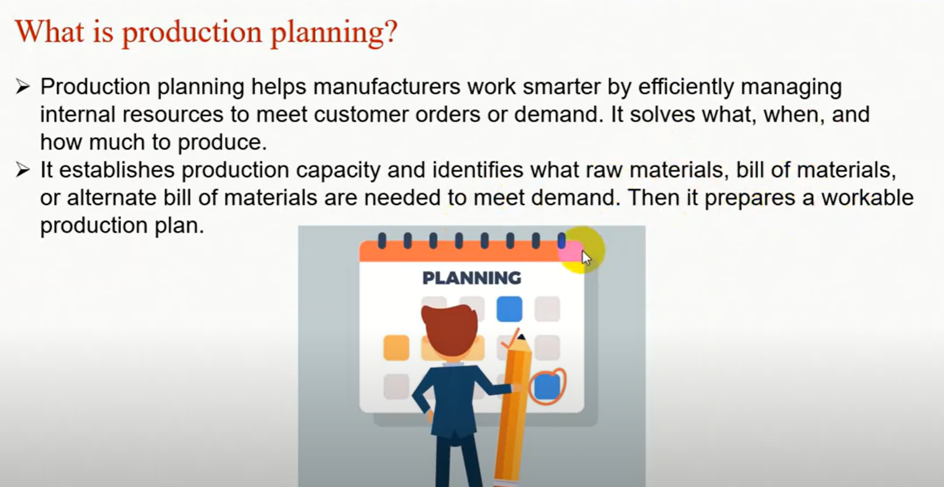

Slide 35
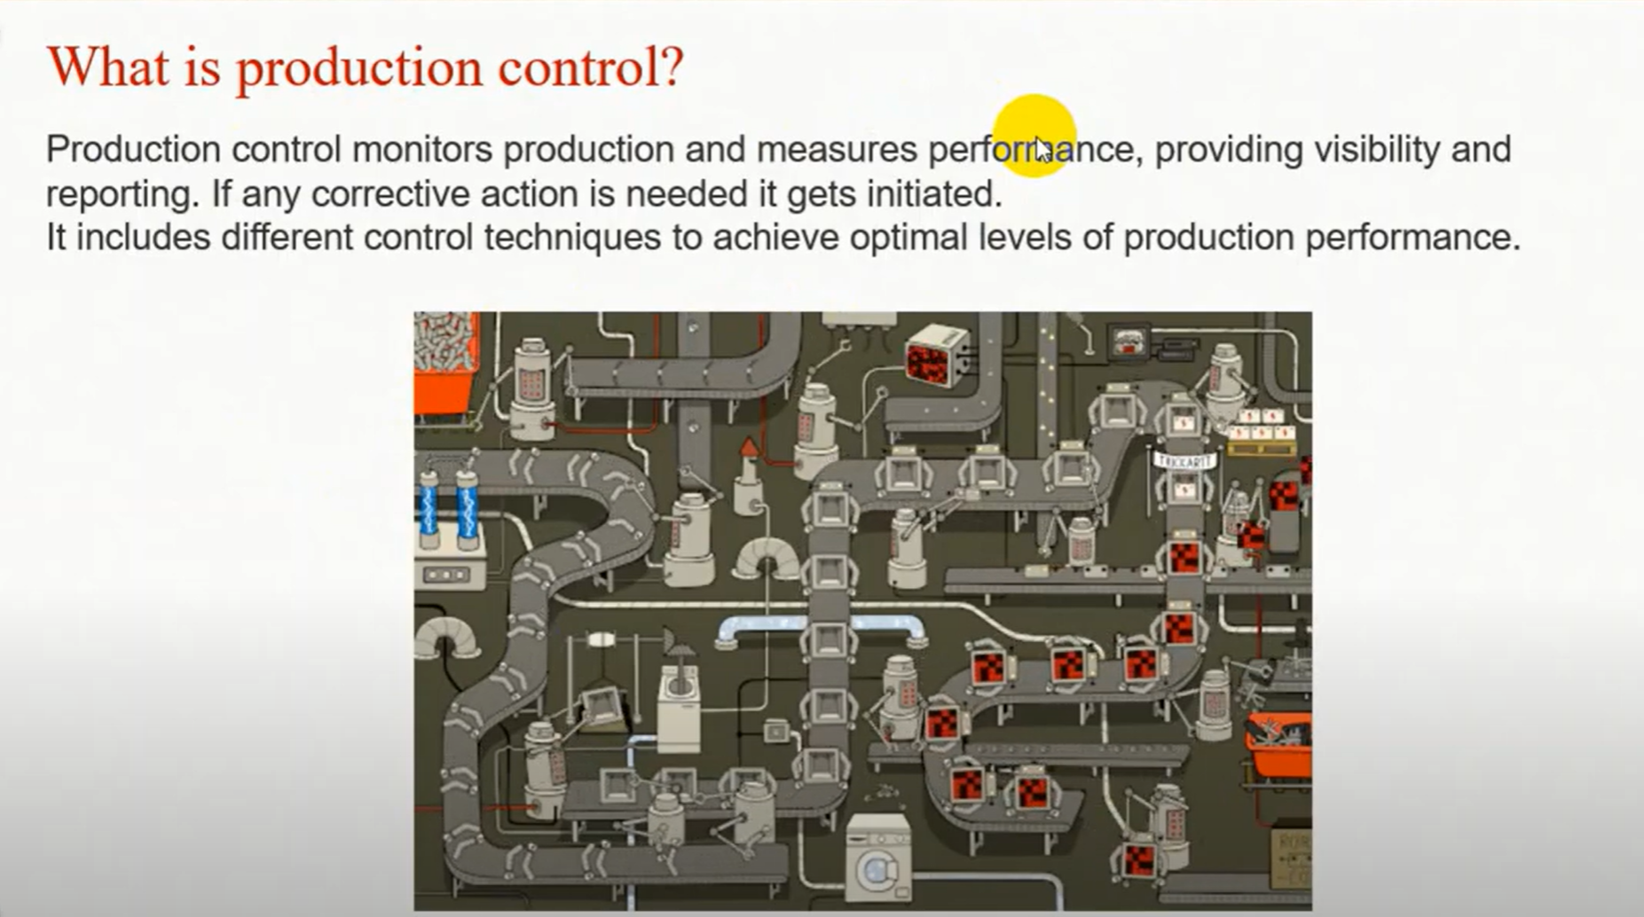

Slide 36
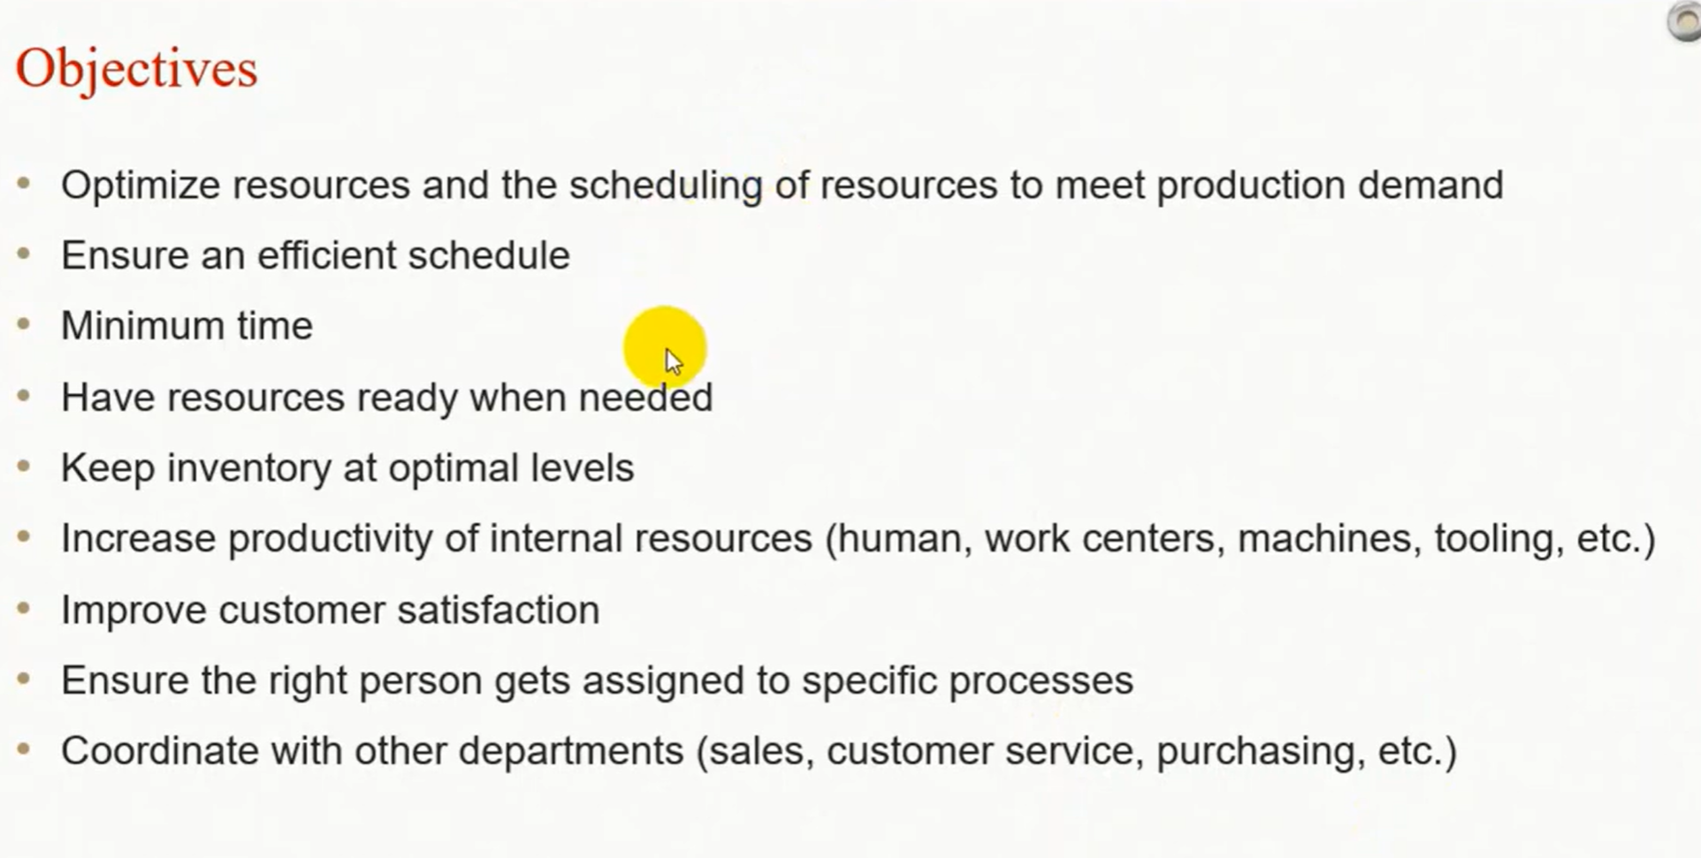

Slide 37
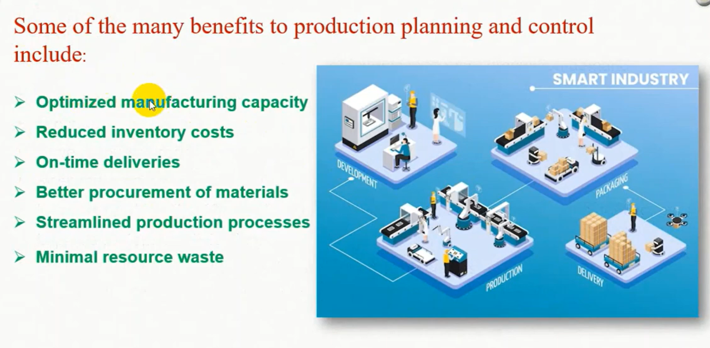

Slide 38
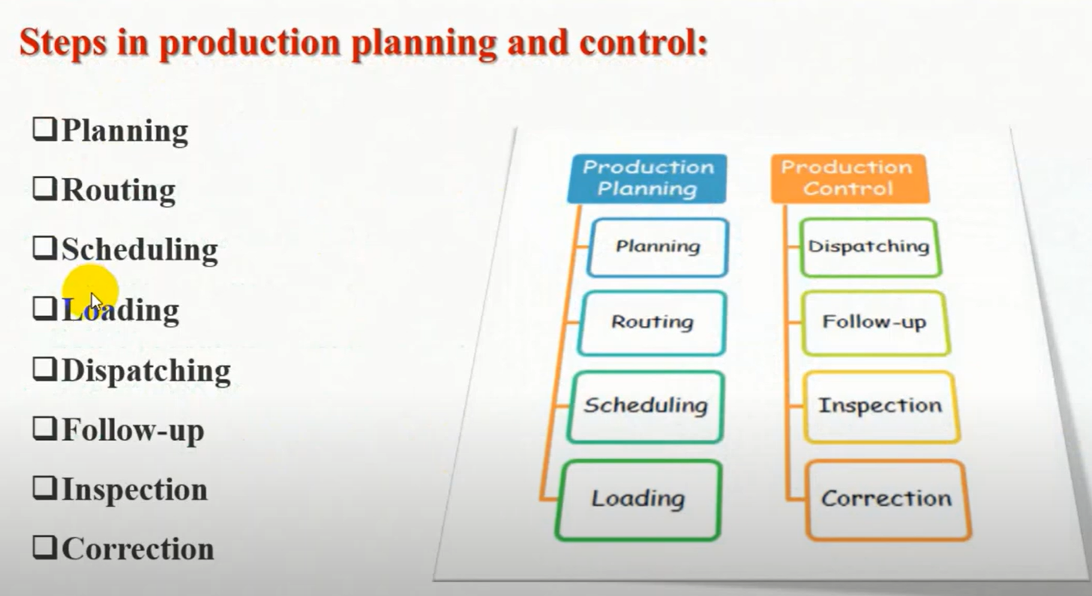

Slide 39
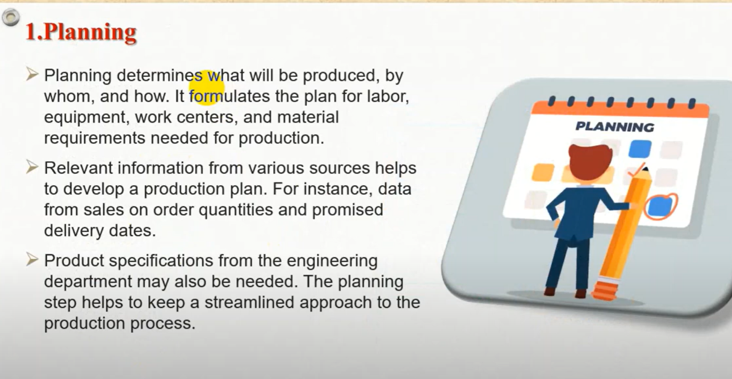

Slide 40
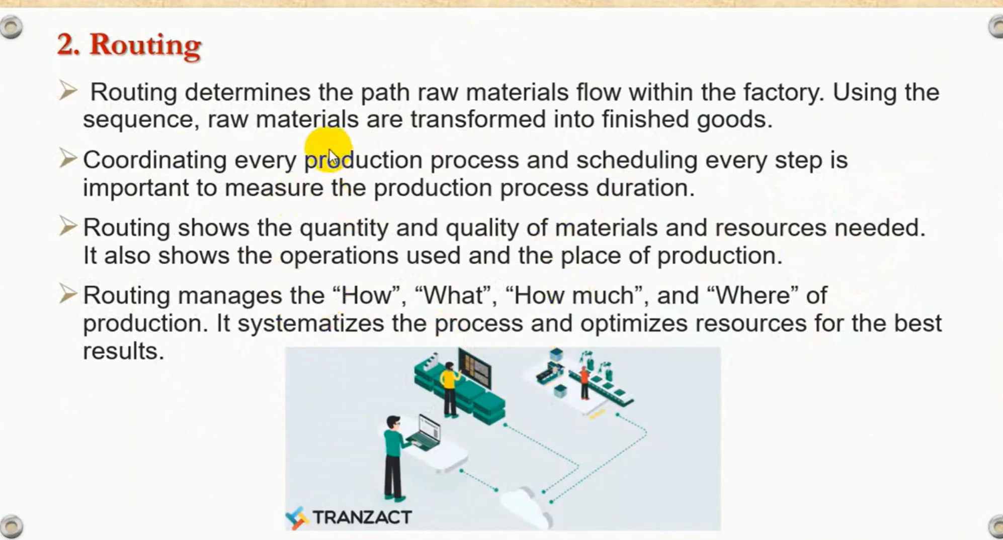

Slide 41
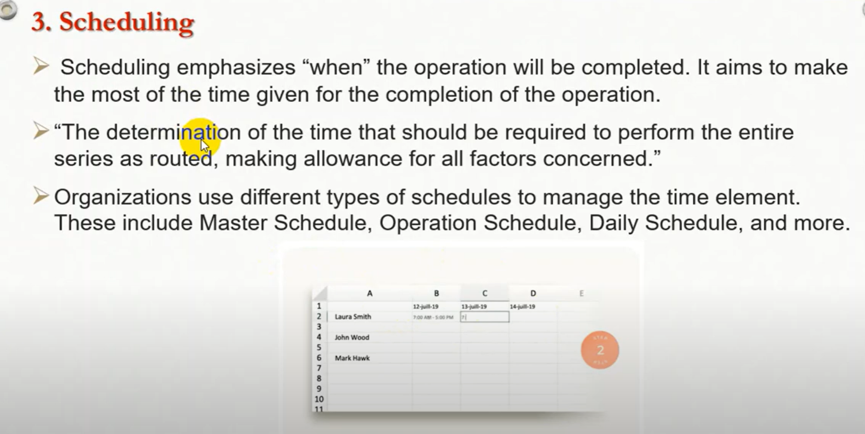

Slide 42
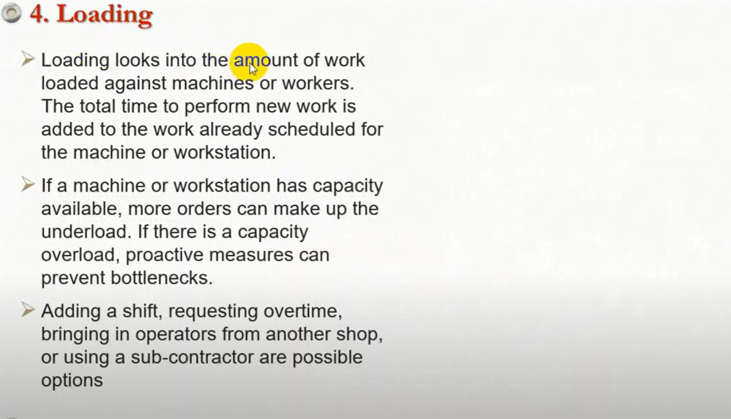

Slide 43
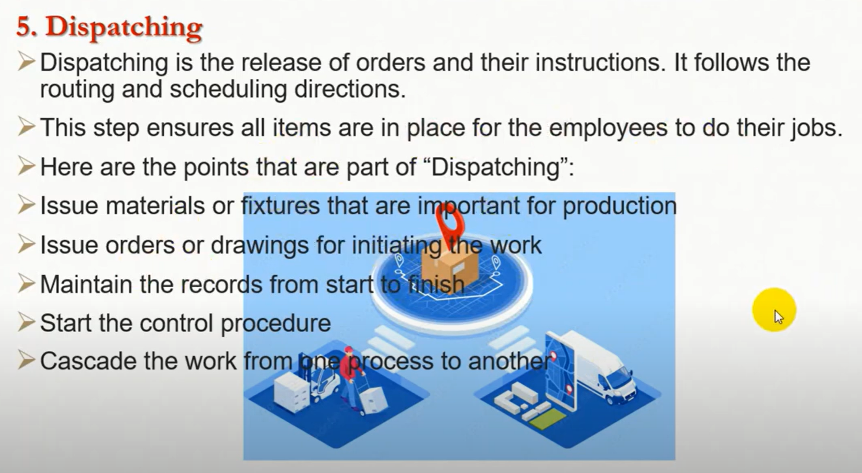

Slide 44
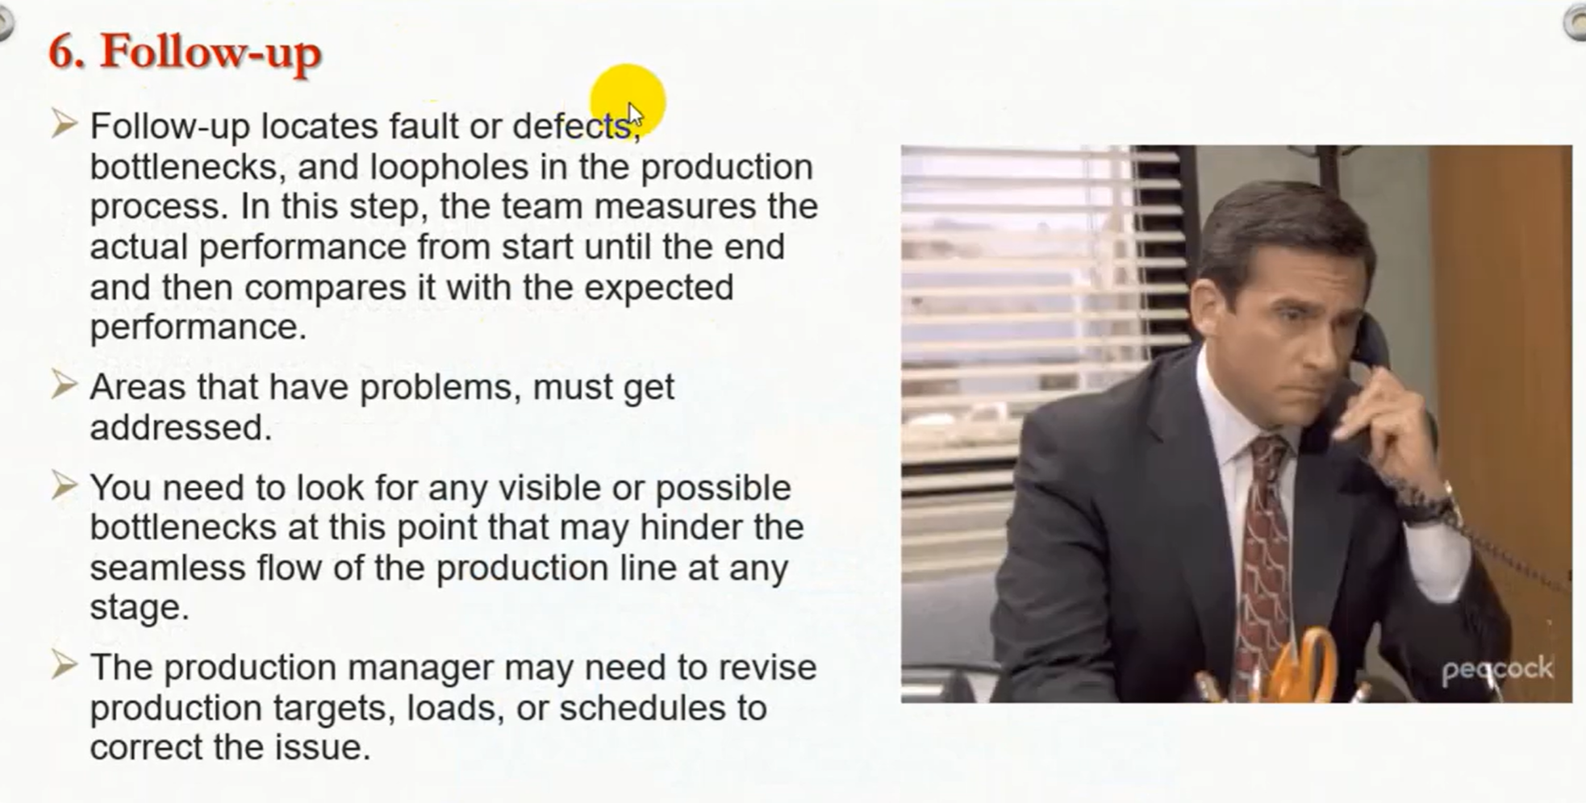

Slide 45
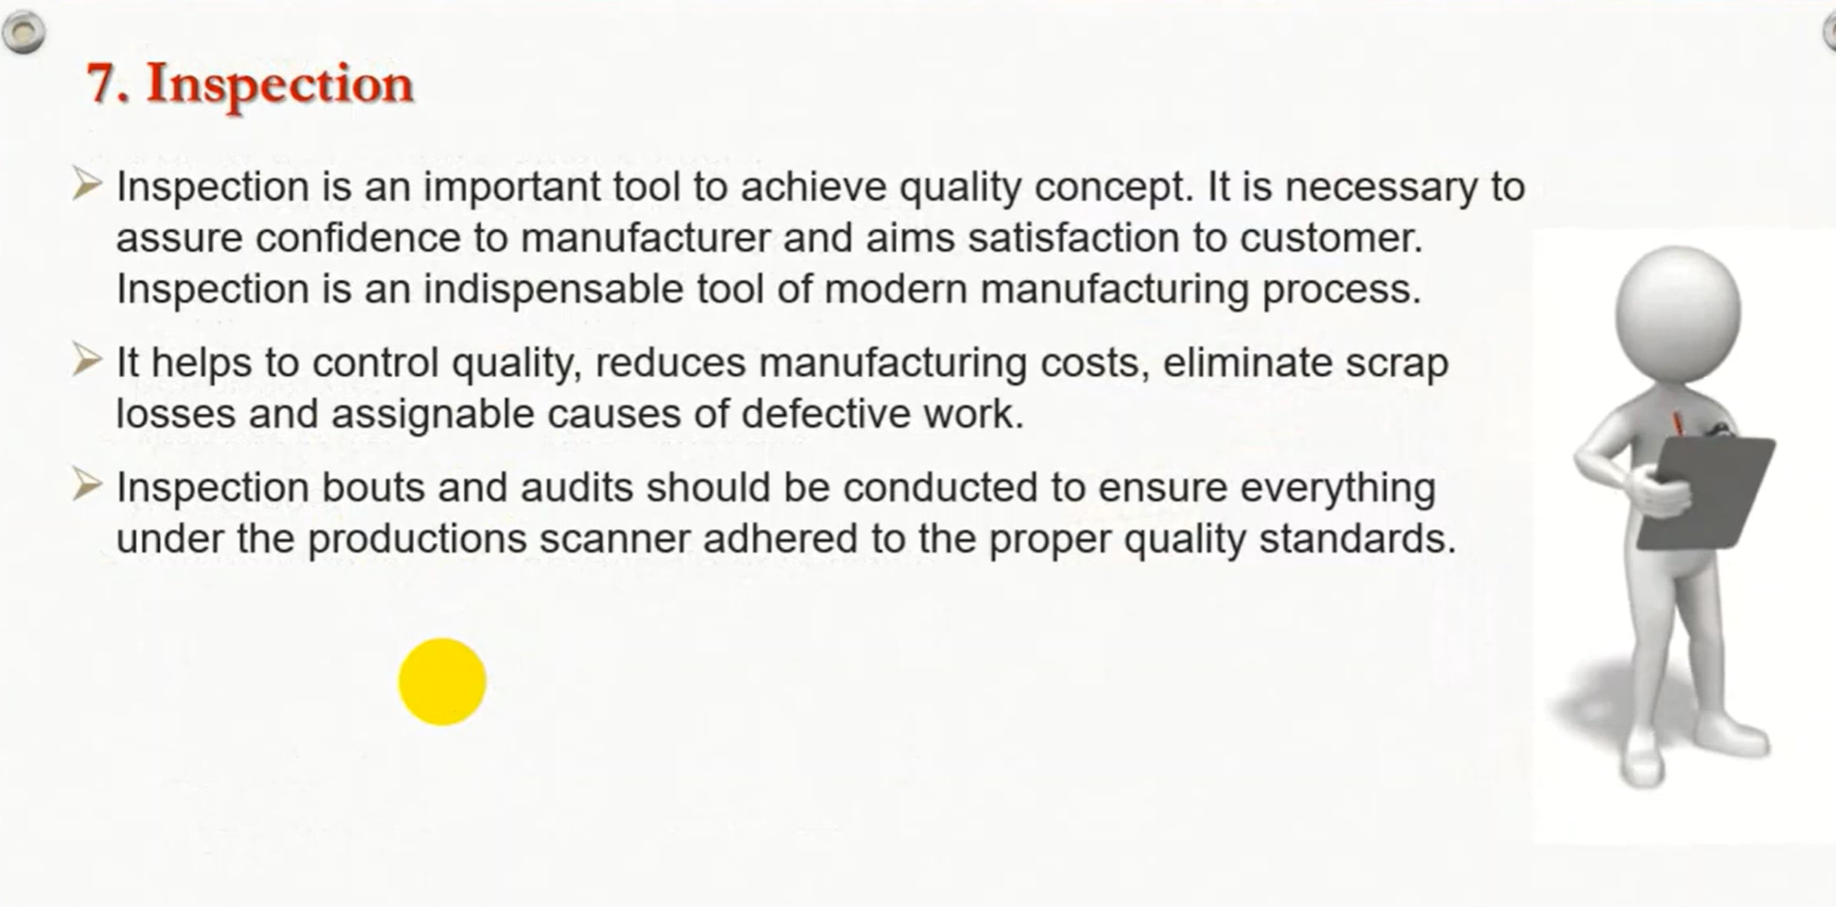

Slide 46
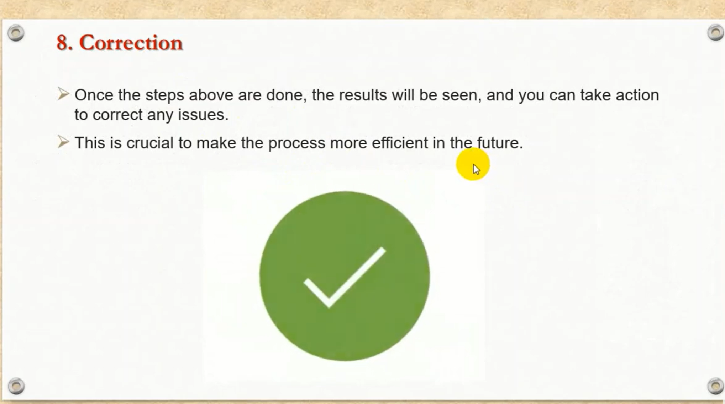

Slide 47
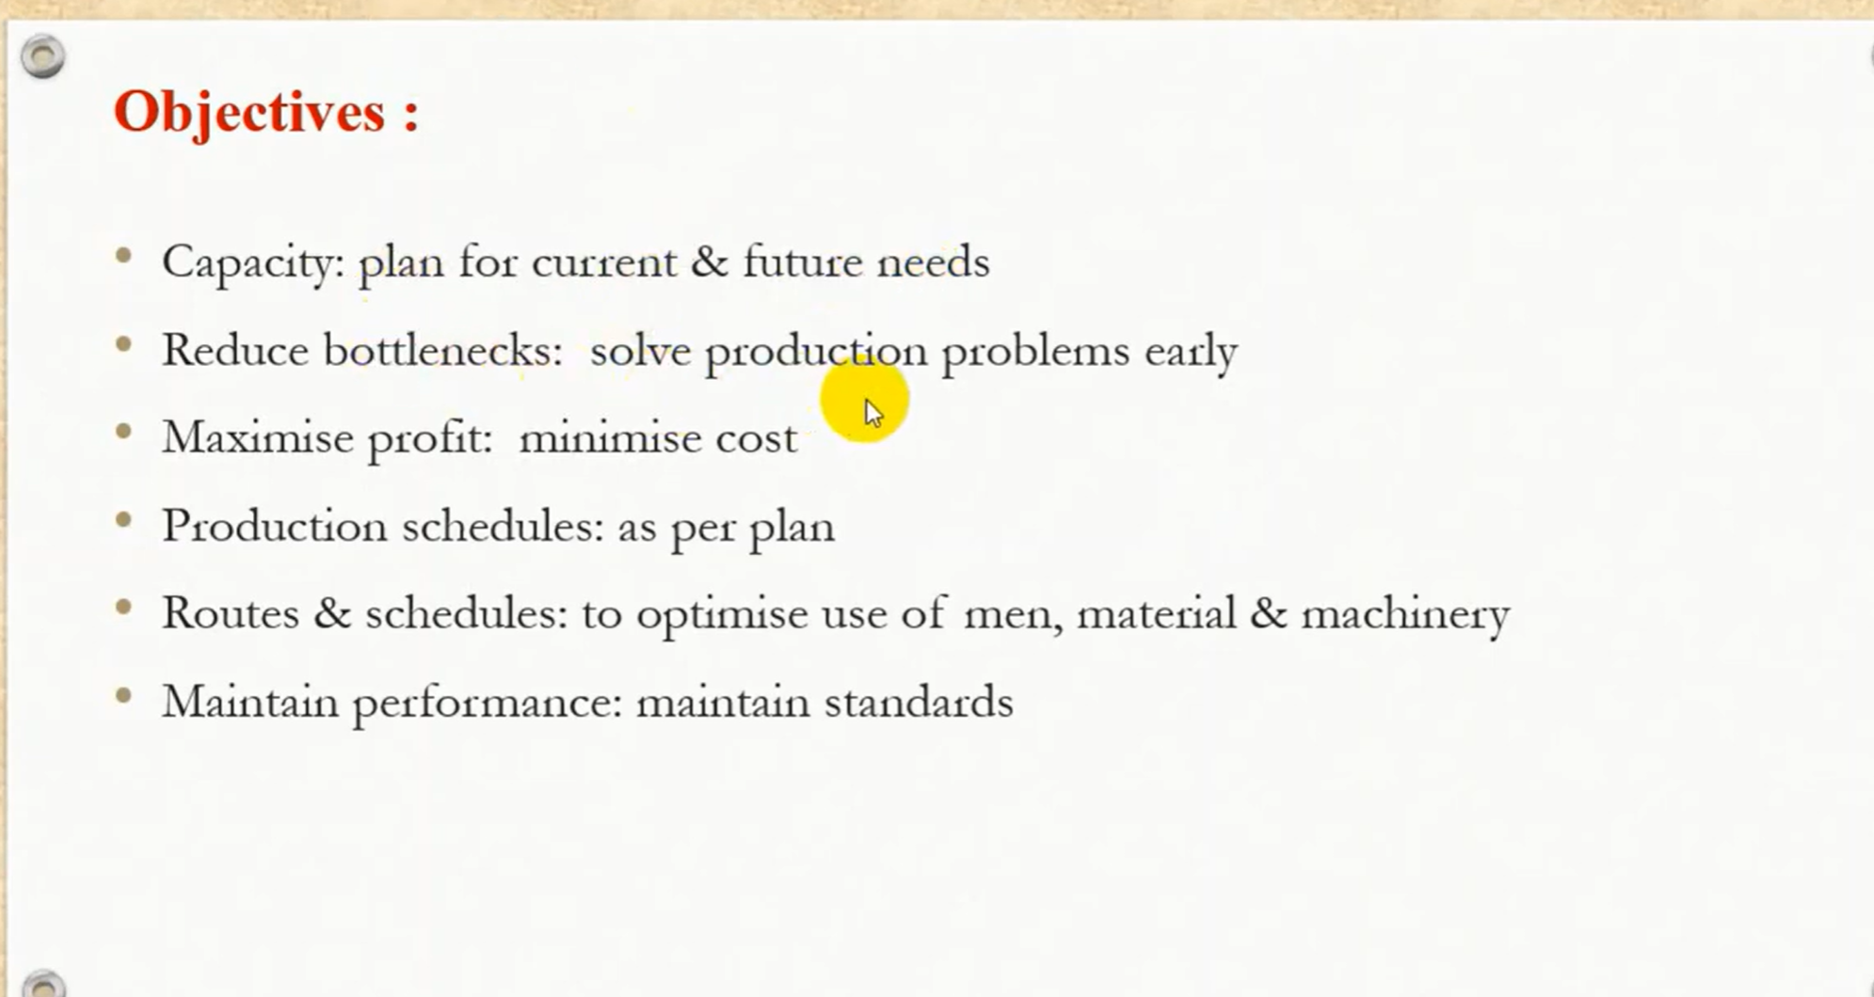

Slide 48
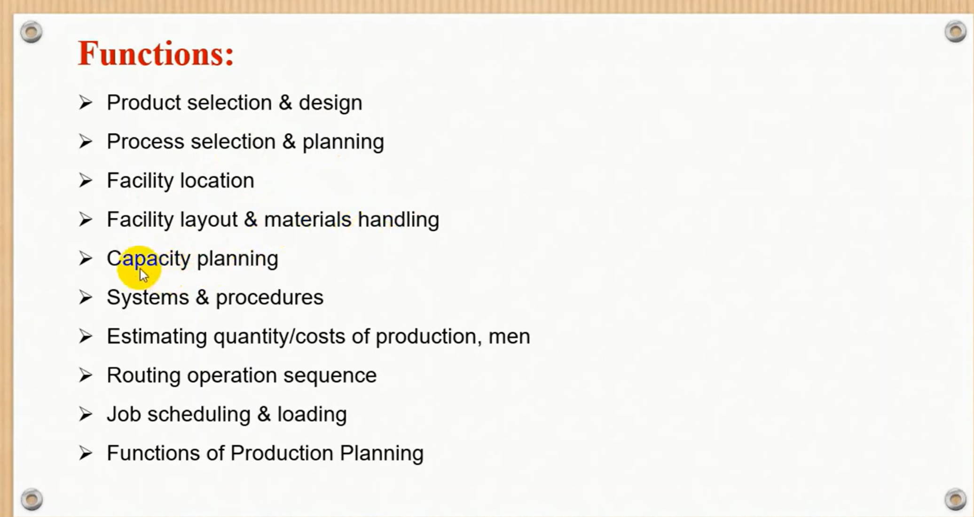

Slide 49
Plant layout is a plan of optimum management of facilities which include; personnel, operating equipment, storage space, material handling equipment, and all other support services
Types of Plant Layout
The following are the popular types of plant layout:
(1) Process layout :Involves the arrangement of similar machines in a group in one department/one area according to the functions performed in the department e.g. welding machines. (2) Product layout It involves the arrangement of machines in one line depending on the sequence of operations.
The material is fed into the first machine and finished products come out of the last machine. e.g. Sugarcane to sugar, Bamboo to paper, plastic to plastic smart cards production
(3) Combined layout (4) Static product layout or Project layout
(5) Cellular layout (6) Job Shop layout.

Slide 50
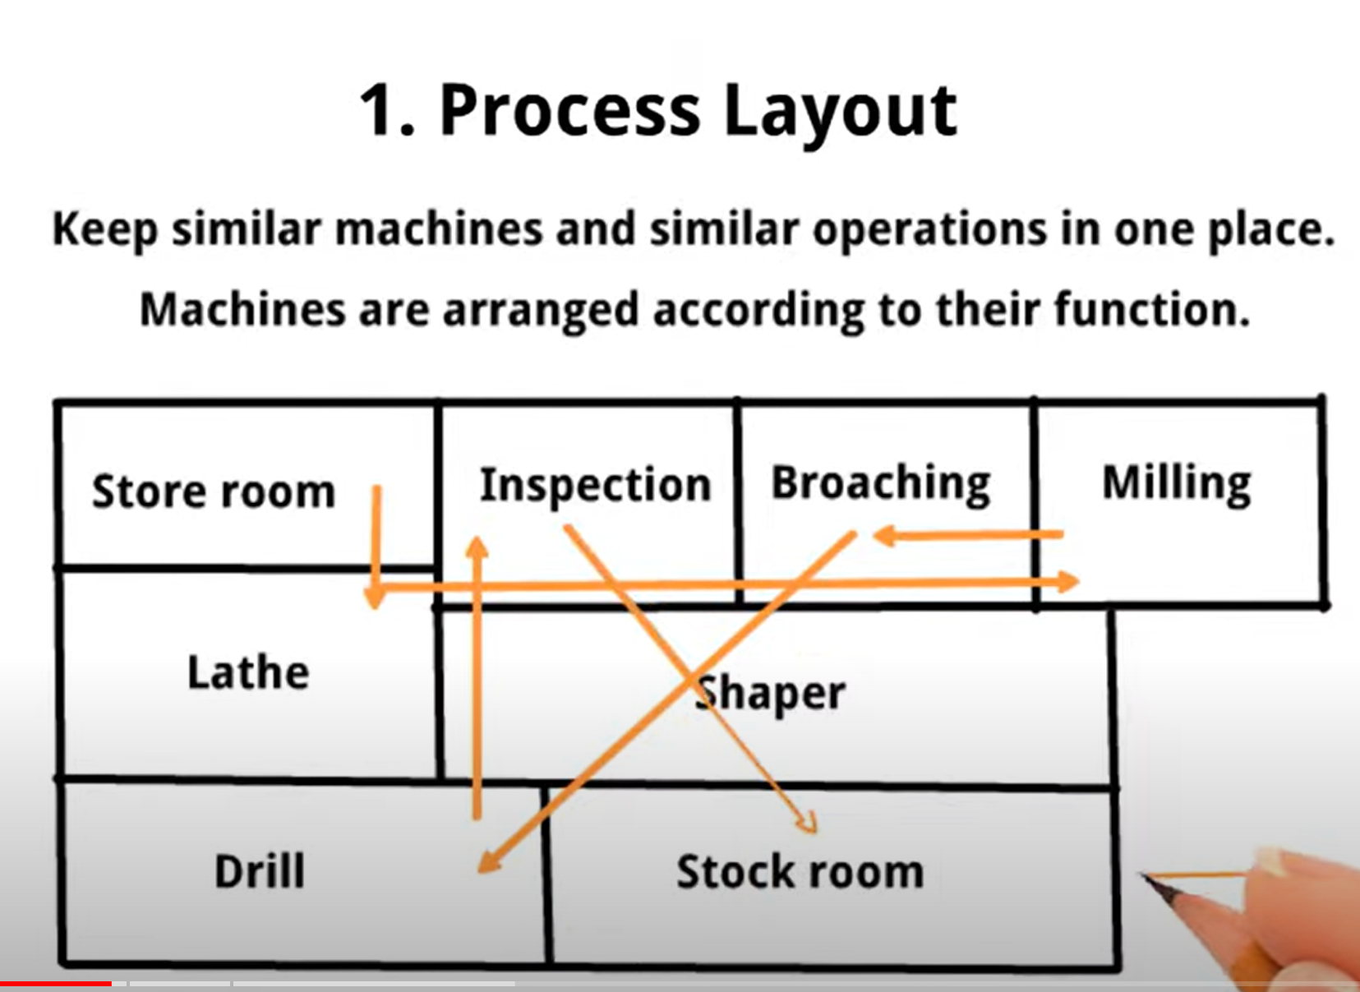

Slide 51
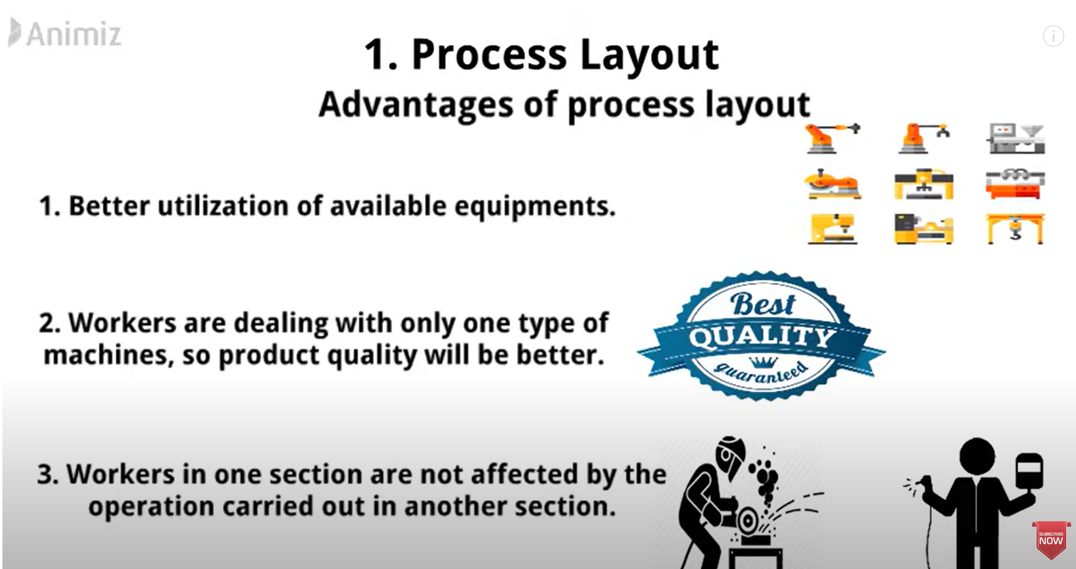

Slide 52
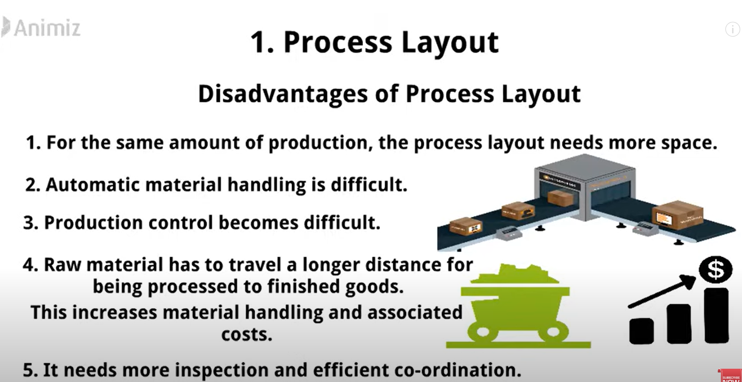

Slide 53
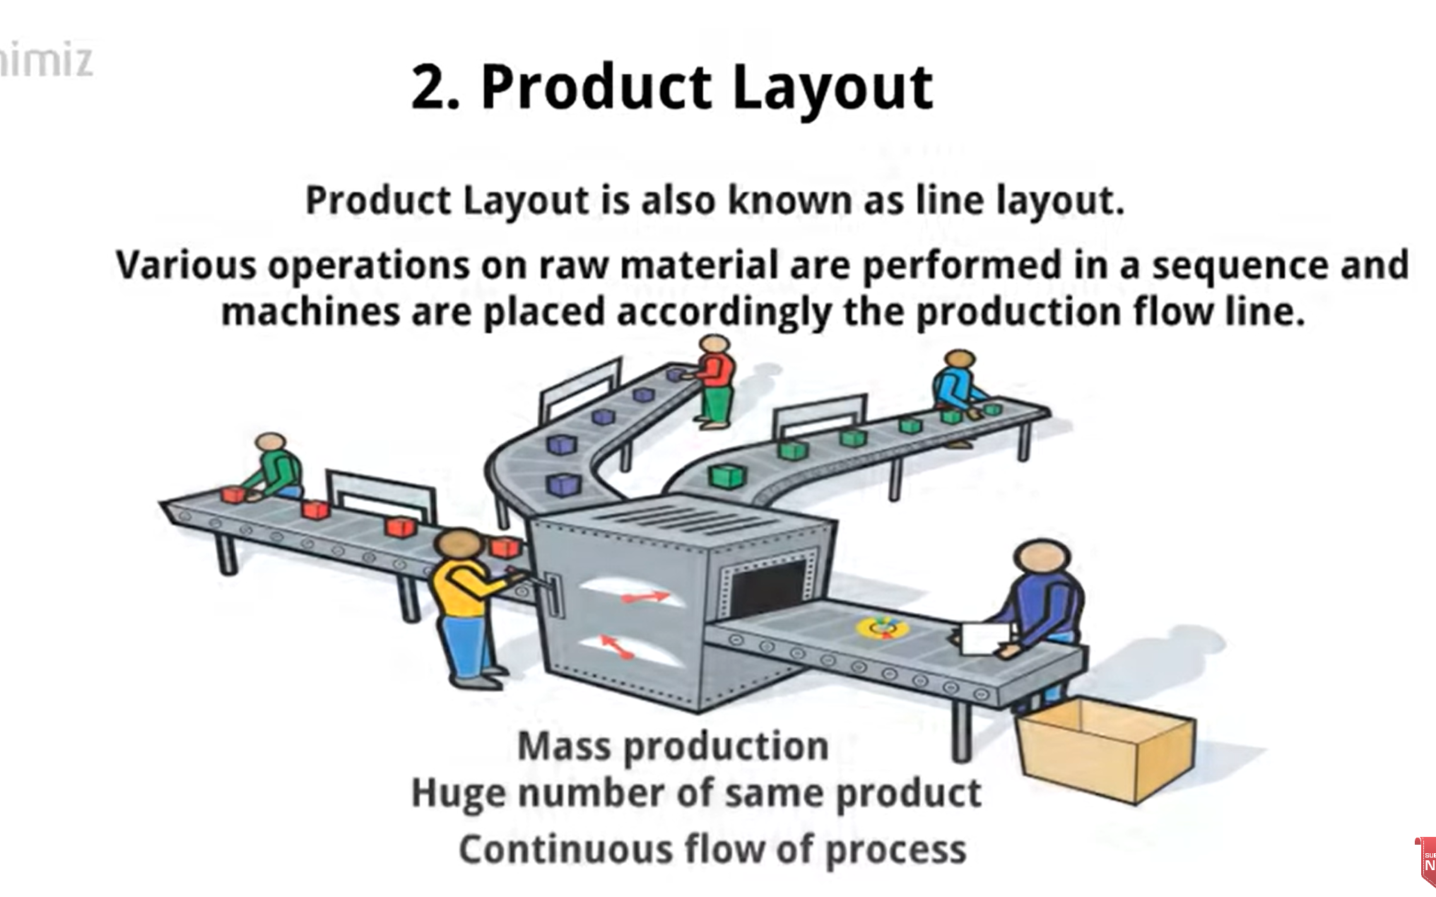

Slide 54
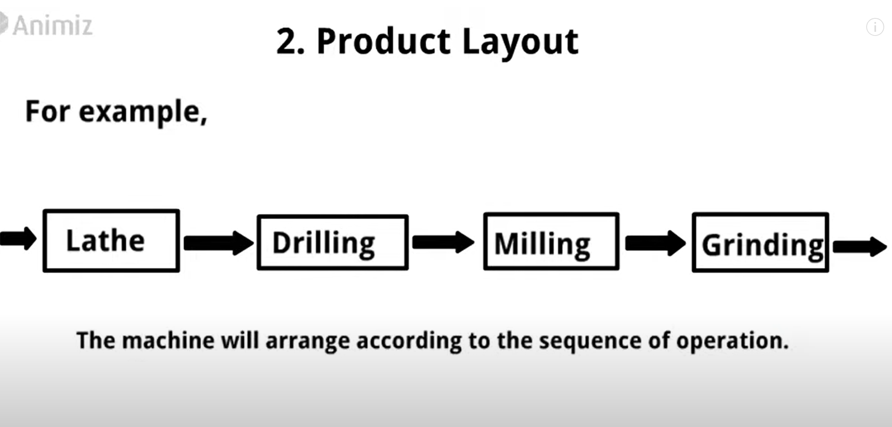

Slide 55
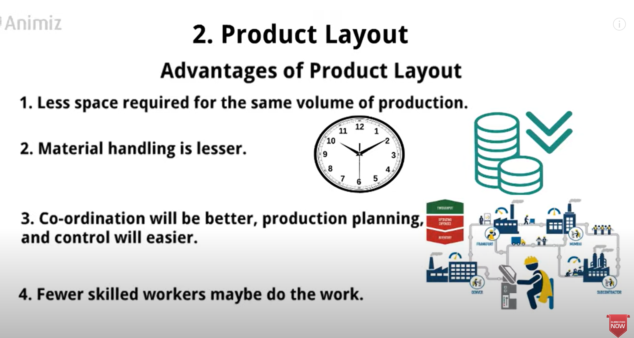

Slide 56
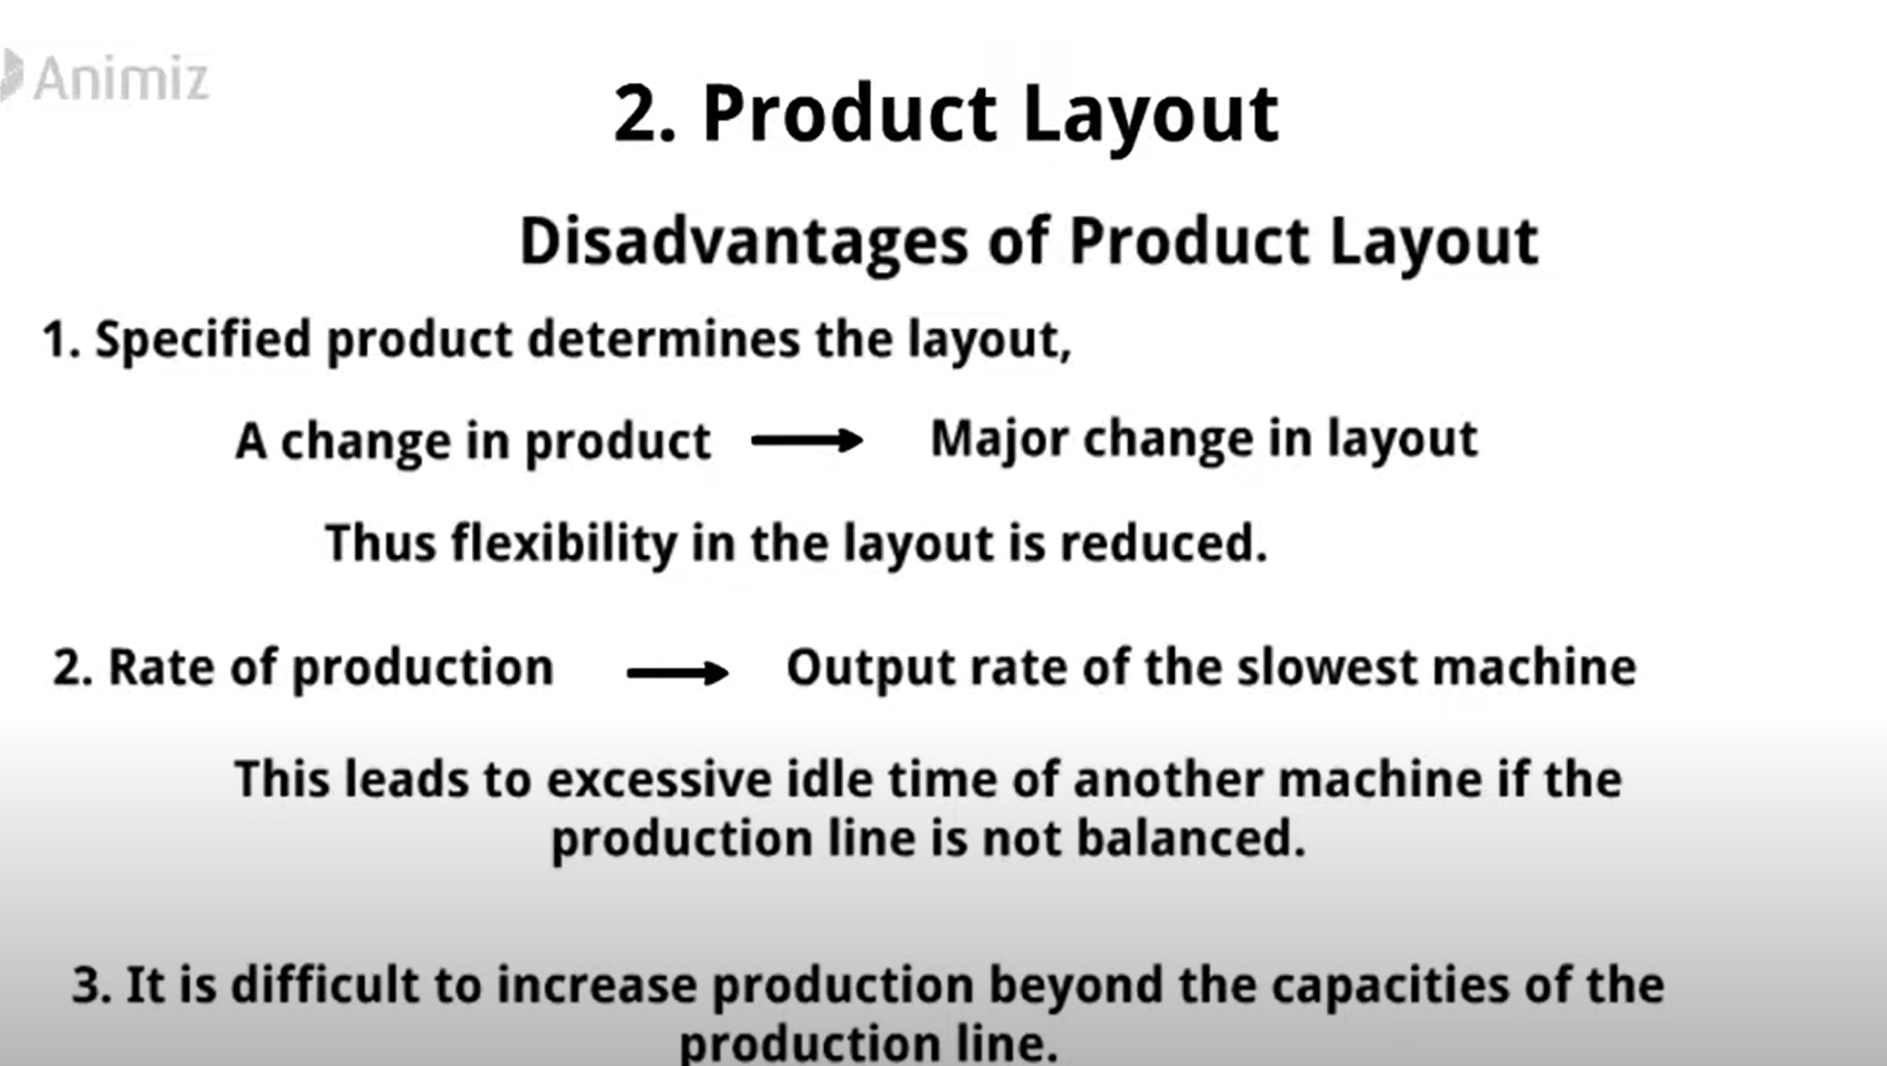

Slide 57
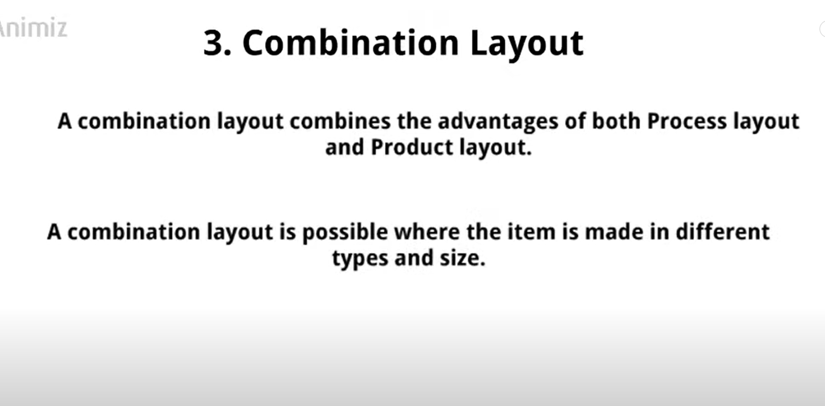

Slide 58
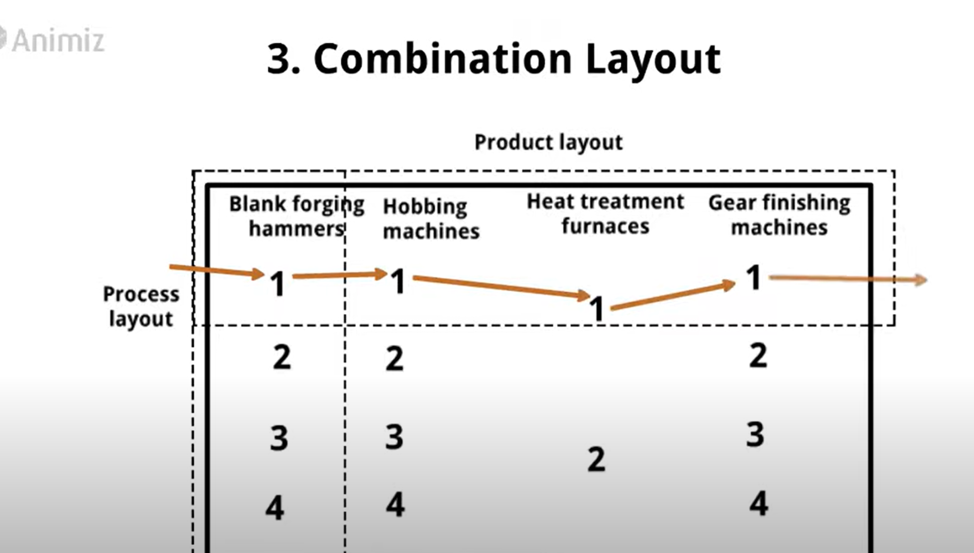

Slide 59
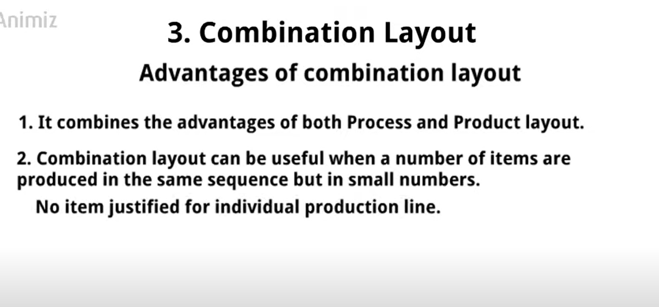

Slide 60
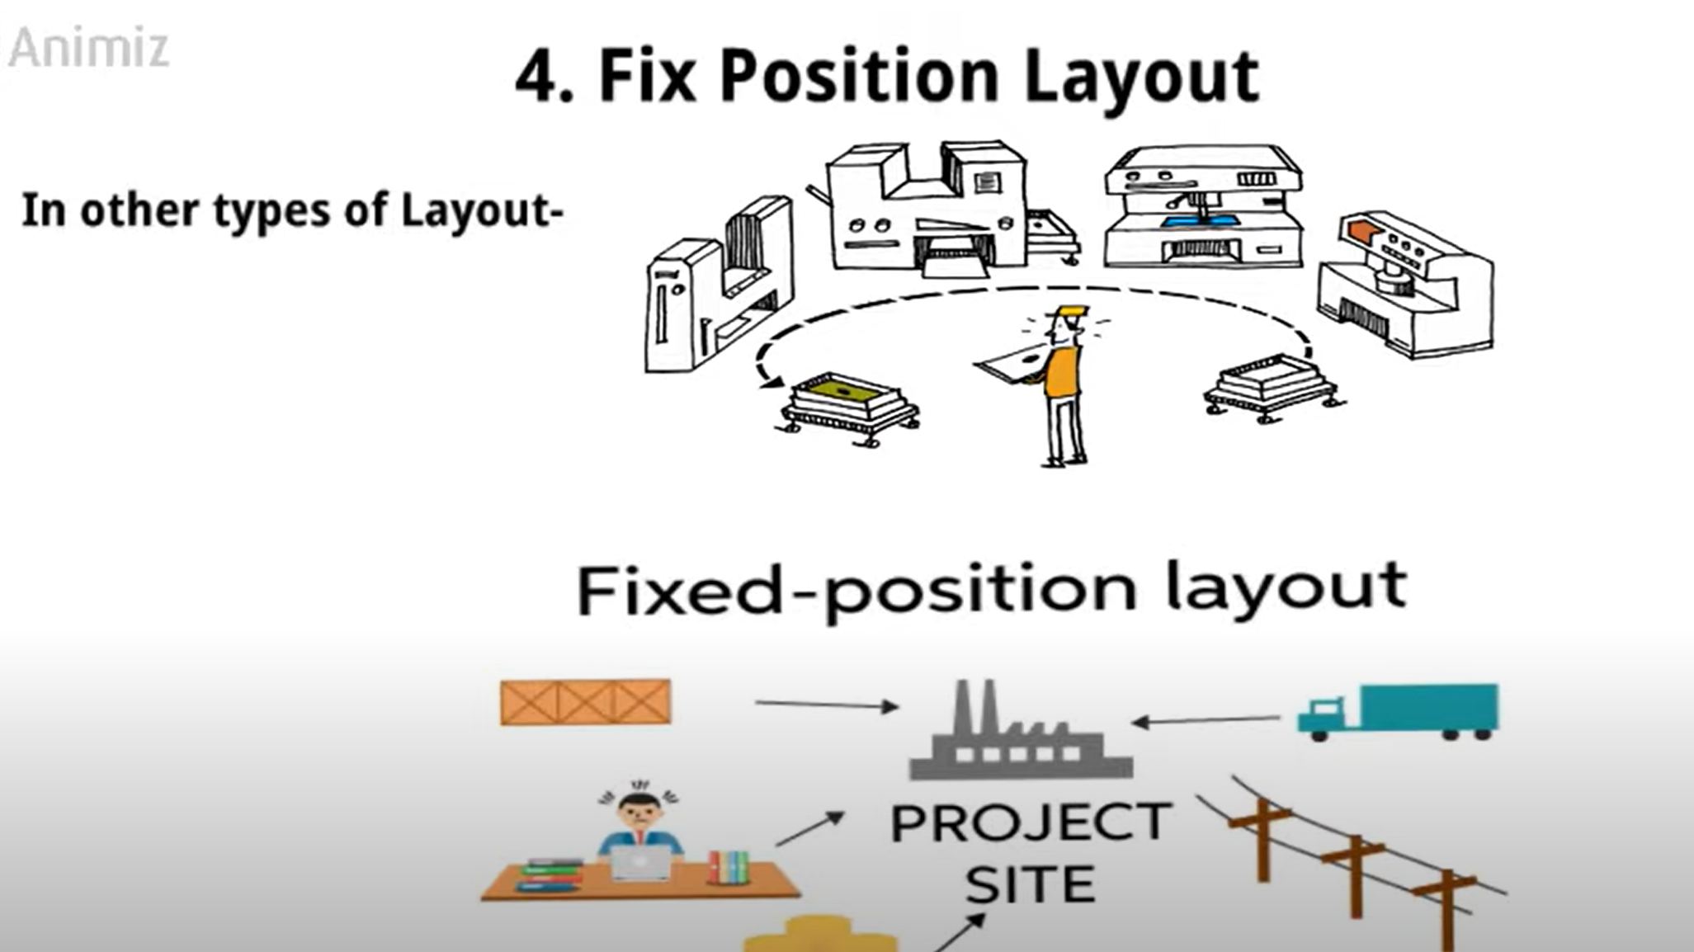

Slide 61
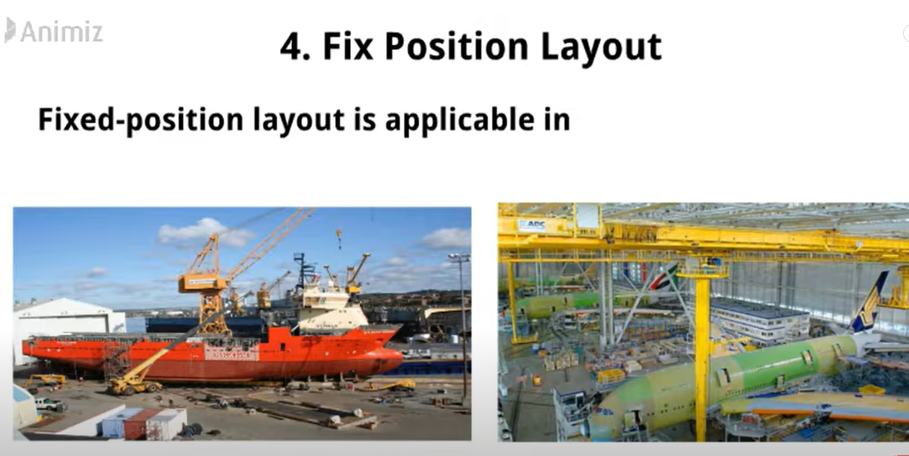

Slide 62
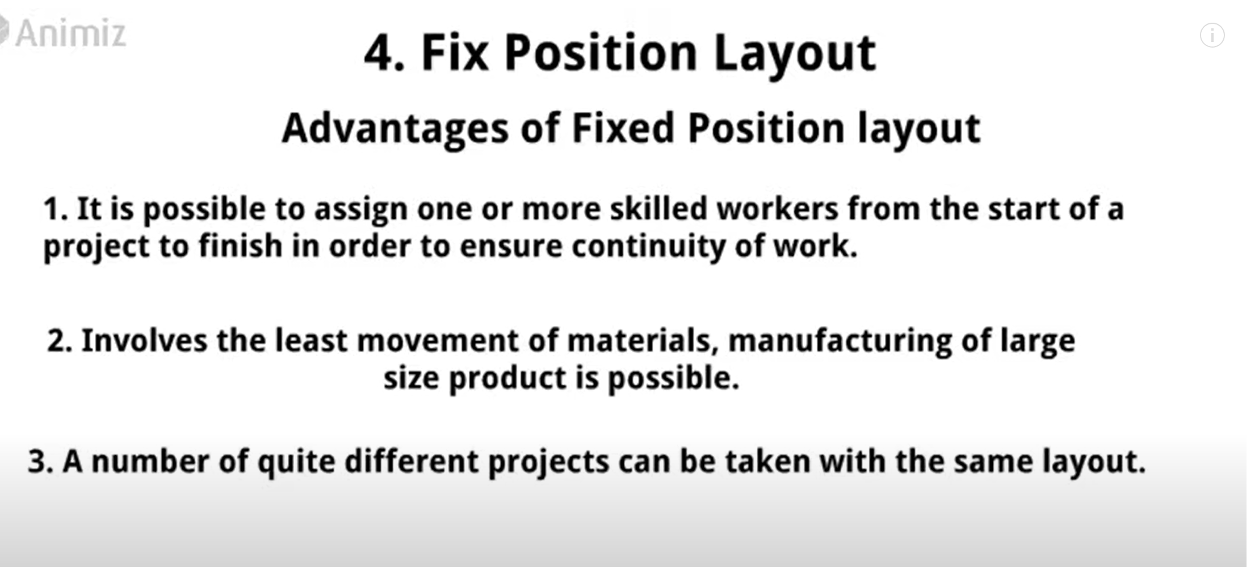

Slide 63
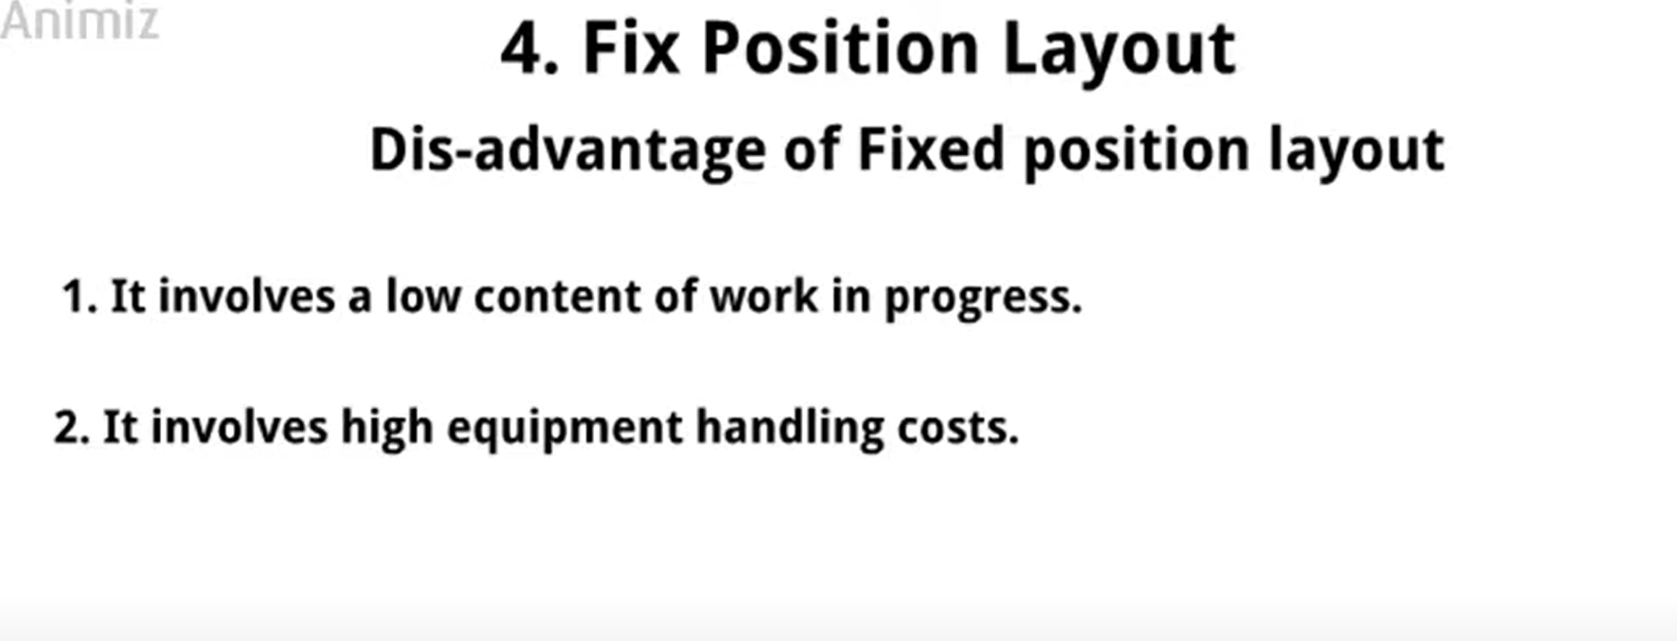

Slide 64
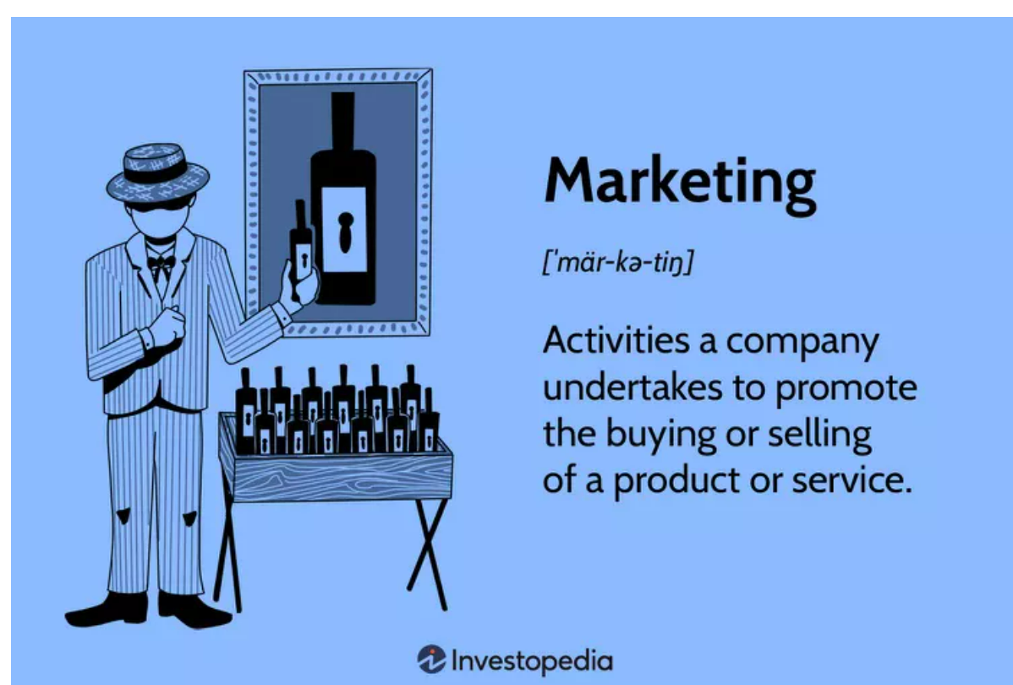

Slide 65
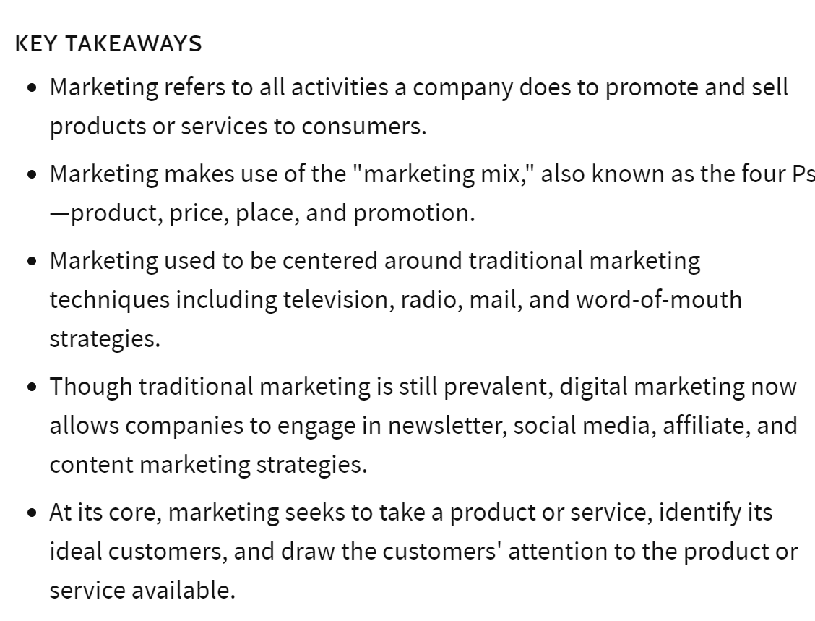

Slide 66
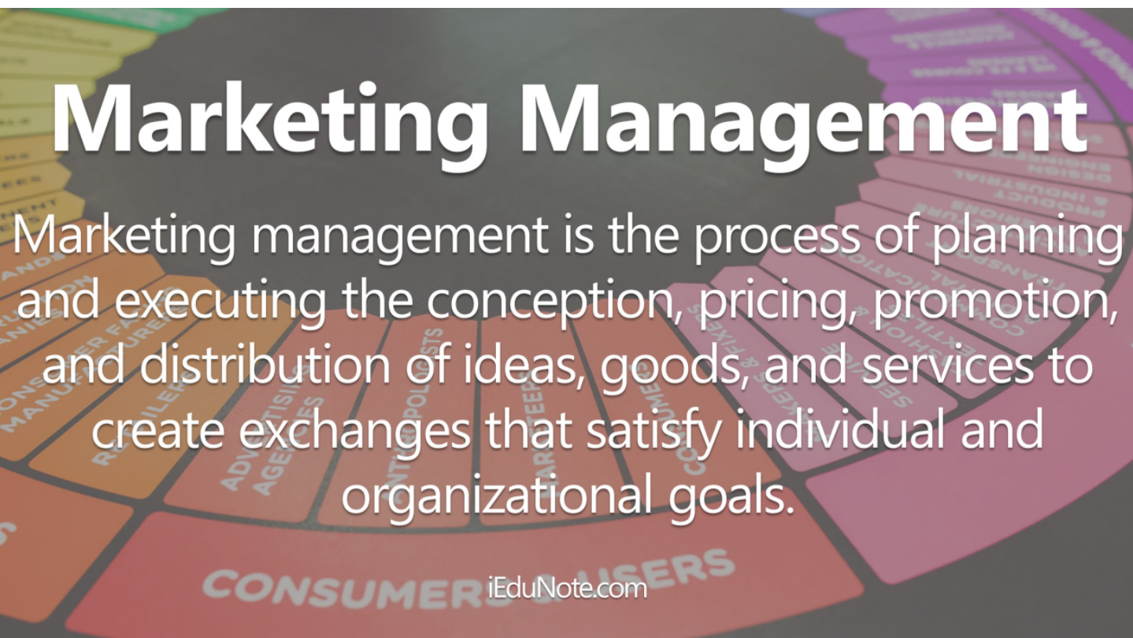

Slide 67
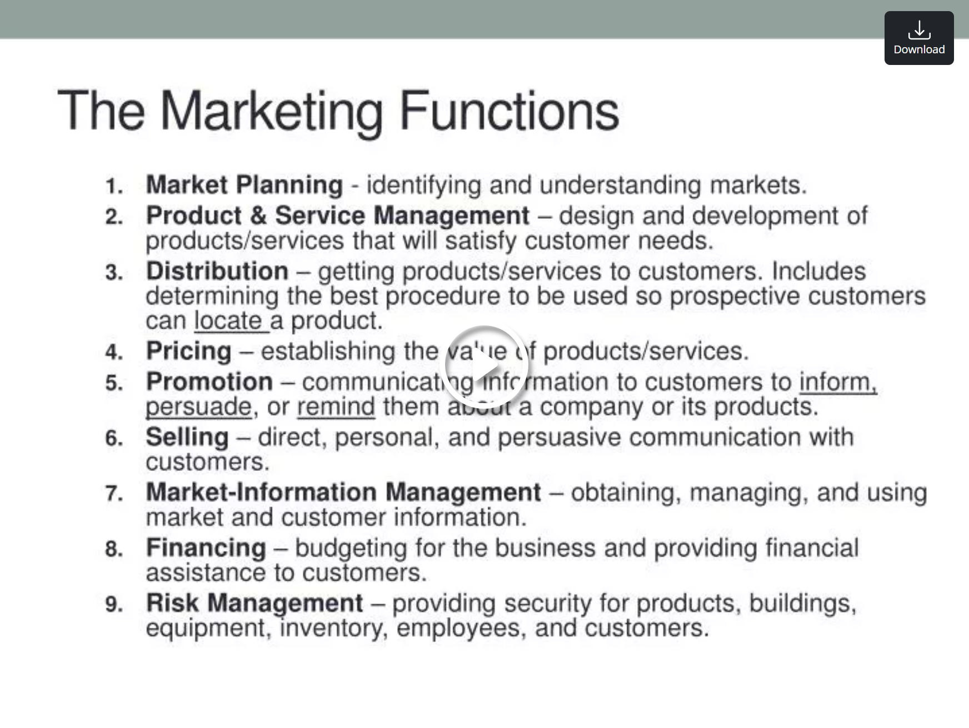

Slide 68
MARKETING MANAGEMENT
Defnition: Marketing is a social process by which individuals and groups obtain what they need and want through creating, offering and freely exchanging products and services of value with others-----Philip Kotler
Functions of Marketing
1.Selling
2. Buying
3. Transportation
4.storage
5. Standardization & Grading
6. Financing
7. Risk taking
8. Market information

Slide 69
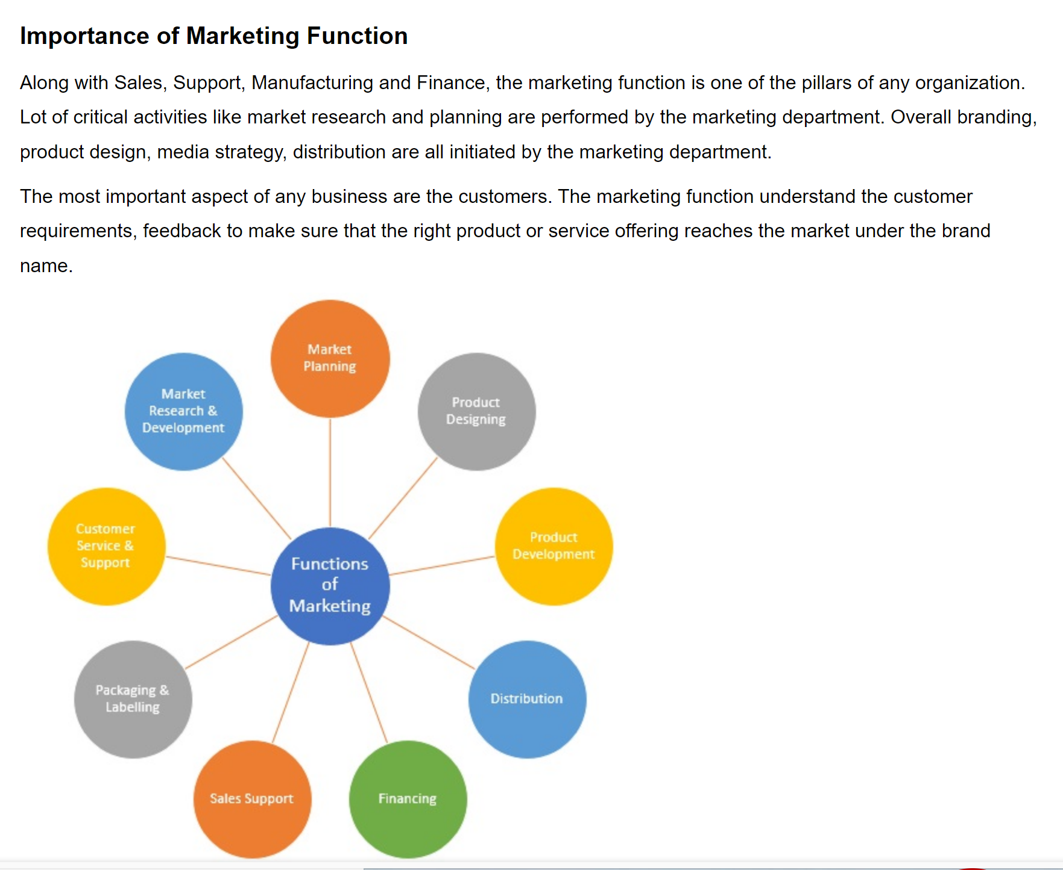

Slide 70
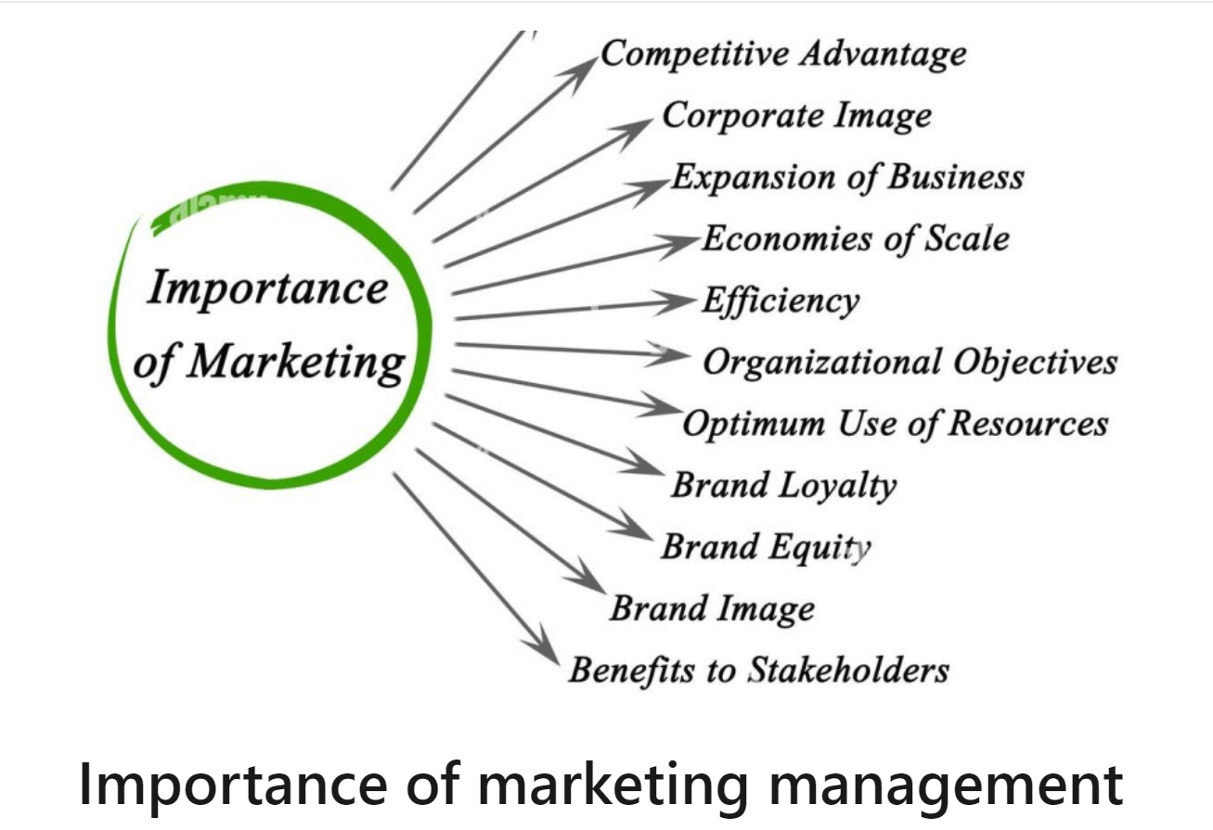

Slide 71
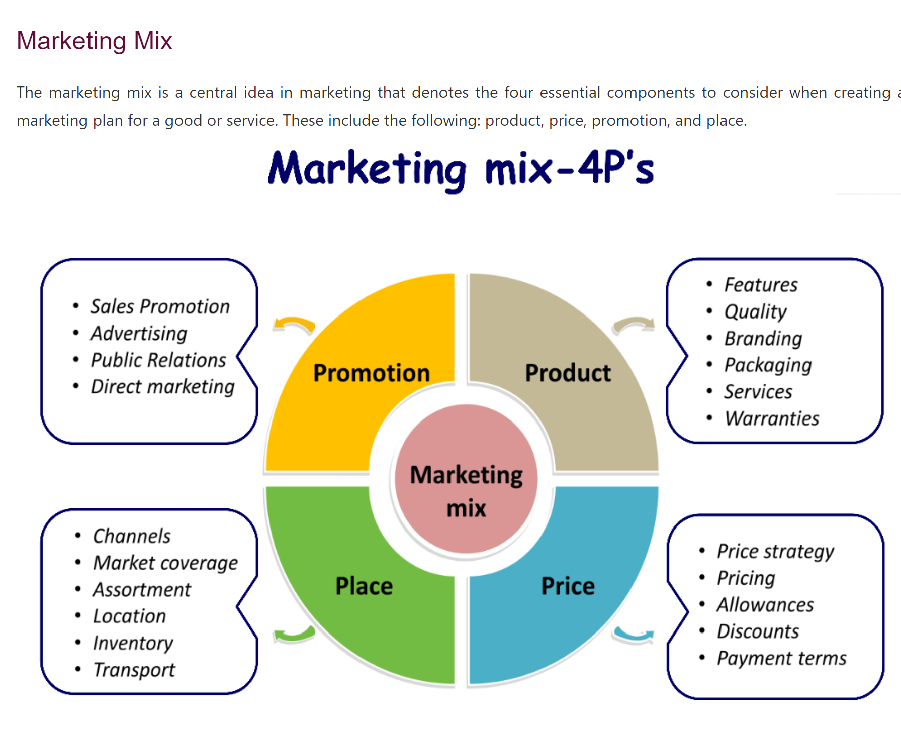

Slide 72
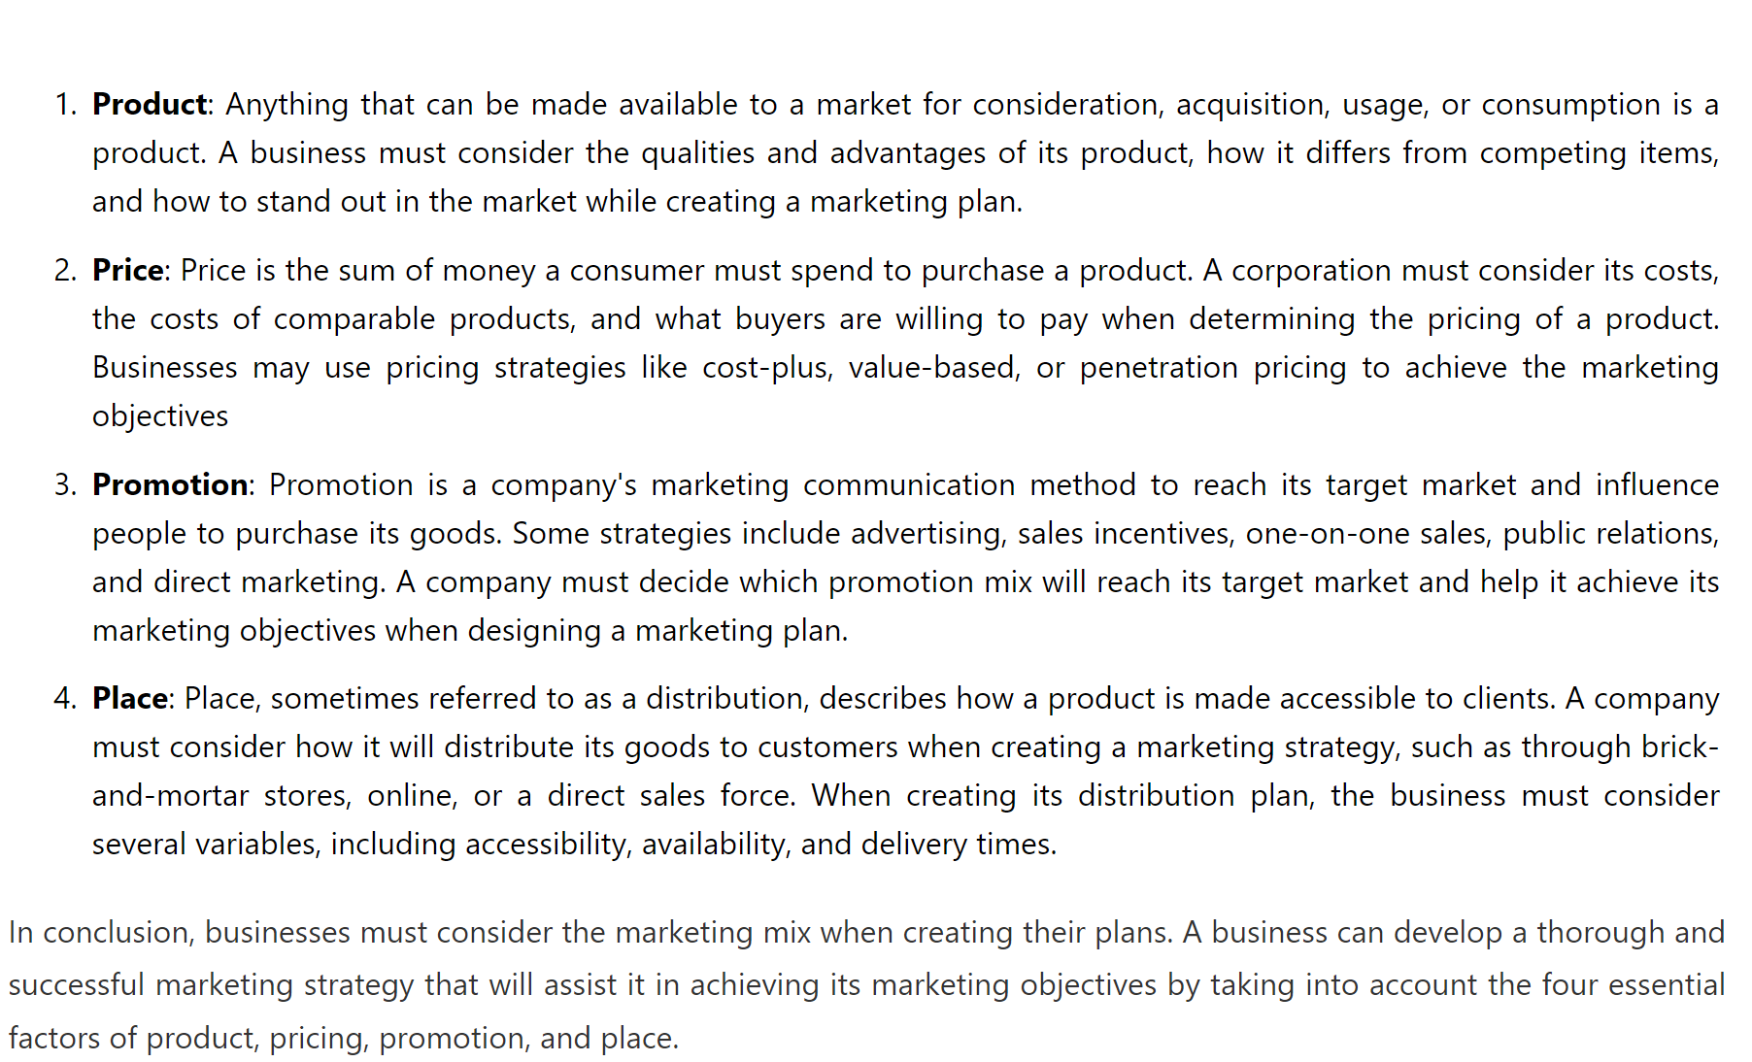

Slide 73
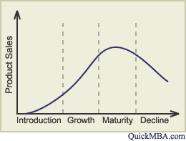
MARKETING STRATEGIES BASED ON PRODUCT LIFE CYCLE (PLC):
The Product Life Cycle (PLC) is used to map the lifespan of a product. There are generally four stages in the life of a product. These four stages are the Introduction stage, the Growth stage, the Maturity stage and the Decline stage. The following graph illustrates the four stages of the PLC:

Slide 74
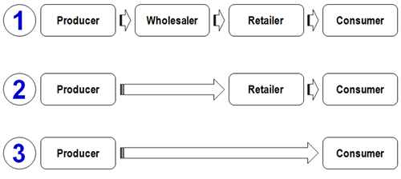
Channels of Distribution: A channel of distribution or trade channel is defined as the path or route along which goods move from producers or manufacturers to ultimate consumers or industrial users.
A marketing or trade channel is a set of interdependent organizations involved in the process of marketing a product or service available for use or consumption"

Slide 75


Slide 76


Slide 77


Slide 78


Slide 79


Slide 80


Slide 81


Slide 82
Functions of HR Manager:
Managerial functions
Planning
Organizing
Staffing
Directing
Controlling
Operative functions
The operative functions of HRM are related to specific activities of personnel management, viz.,
Procurement II) Development III) Motivation & Compensation IV) Maintenance Integration

Slide 83
Procurement:
Job Analysis 2) Human resource Planning 3) Recruitment and selection
4) Placement 5) Induction & orientation 6) Internal Mobility.
2) Development: 1)Training & Development 2)career planning and development 3) Human resource development
3) Motivation & compensation:
Job design 2) work scheduling 3) Job evaluation 4) performance appraisal
5) Compensation Administration 6) Incentives and benefits.
4) Maintenance and Integration:
Healthy and safety 2) Employee welfare 3) social security 4) Grievance redressal
5) Collective bargaining 6) Employee participation 7) Industrial relations 8) Trade union & Association.

Slide 84
JOB EVALUATION
Job evaluation is a systematic way of determining the value/worth of a job in relation to other jobs in an organization
BENEFITS OF JOB EVALUATION
It helps the management in establishing an objective rationale for acceptable wage-structure.
It takes into account many factors other than the skill difference.
It helps in skill match with job. It is helpful in the selection, training and promotion of workers.
It establishes cordial labour relationship.
It helps in determining the rate of a new job.
Job Evaluation Methods
There are 4 basic and traditional systems of job evaluation:
Ranking System 2. Job Classification or Grading system
3. Factor Comparison System, and 4. Point System.

Slide 85
Ranking: The simplest and most common technique for job evaluation employees.
Point Method: A more complex job evaluation technique, the point method, requires evaluators to assign points to a number of compensation characteristics based on skill level, responsibility, effort required and working conditions.
Factor Comparison:Factor comparison is a process that human resources professionals use to evaluate and compare different job candidates. By evaluating factors such as education, experience, skills, and qualifications, human resources professionals can identify the best candidates for a given position.
Job Classification: The classification method requires that evaluators categorize jobs into groups with relatively the same value to a business. The groups are commonly called grades.

Slide 86
Financial Management
Meaning:
Financial Management means planning, organizing, directing and controlling the financial activities such as procurement and utilization of funds of the enterprise.
Scope/Elements of Financial Management
Investment decisions includes investment in fixed assets (called as capital budgeting). Investment in current assets are also a part of investment decisions called as working capital decisions.
Financial decisions- They relate to the raising of finance from various resources which will depend upon decision on type of source, period of financing, cost of financing and the returns thereby.
Dividend decision- The finance manager has to take decision with regards to the net profit distribution.

Slide 87


Slide 88


Slide 89


Slide 90


Slide 91
Objectives of Financial Management
The financial management is generally concerned with procurement, allocation and control of financial resources of a concern. The objectives can be-
To ensure regular and adequate supply of funds to the concern.
To ensure adequate returns to the shareholders which will depend upon the earning capacity, market price of the share, expectations of the shareholders.
To ensure optimum funds utilization. Once the funds are procured, they should be utilized in maximum possible way at least cost.
To ensure safety on investment, i.e, funds should be invested in safe ventures so that adequate rate of return can be achieved.
To plan a sound capital structure-There should be sound and fair composition of capital so that a balance is maintained between debt and equity capital.

Slide 92
Functions of Financial Management
1. Estimation of capital requirements:
2. Choice of sources of funds: For additional funds to be procured, a company has many choices like-
Issue of shares and debentures b. Loans to be taken from banks and financial institutions
Public deposits to be drawn like in form of bonds.
3. Investment of funds: The finance manager has to decide to allocate funds into profitable ventures so that there is safety on investment.
4. Disposal of surplus: The net profits decision have to be made by the finance manager.
5. Management of cash: Finance manager has to make decisions with regards to cash management. Cash is required for many purposes like payment of wages and salaries, payment of electricity and water bills, payment to creditors, meeting current liabilities, maintenance of enough stock.
6. Financial controls: The finance manager has not only to plan, procure and utilize the funds but he also has to exercise control over finances. This can be done through many techniques like ratio analysis, financial forecasting, cost and profit control, etc.

